Slide 1

Bradford
Exempted Village School District
Board of Education Meeting
September 19, 2023

Slide 2
STUDENTS OF THE MONTH

Slide 3
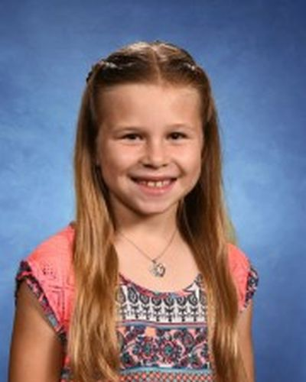
Natalie Rank - Nominated by Ms. Fair
I would like to recognize Natalie Rank for Student Spotlight of the month. Natalie is the oldest of three. She has two younger brothers, Levi and Wyatt. Natalie loves being with her family and friends, being outside, and playing sports. She loves all subjects at school and is a hard worker in each and every one of them. At the beginning of the school year, Natalie started in the other 4th grade homeroom. After a week or so of school we, Natalie’s teachers, decided it would be beneficial to switch her homeroom class. She has handled the switch with such grace and continued to push herself everyday. Natalie is kind to all her classmates and an amazing teacher assistant, which happens to be the job she was recently chosen for in our classroom economy. I am happy to have Natalie in 4th grade this year and I am excited to see what she achieves this school year! Great Job Natalie & Congratulations!

Slide 4
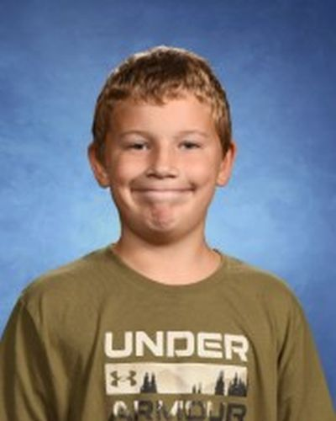
Boston Spurgeon - Nominated by Mrs. Roberts
I would like to nominate Boston Spurgeon for this month’s Student Spotlight. Boston works hard everyday. He comes in with this big smile that you can’t help but smile back! He greets his classmates every morning and really sets a positive tone for our class for the day. Boston is a young man with integrity. I can count on him to always do the right thing even when no one is looking. If there is anything that needs to be done, he is right on it. Boston is an excellent friend. He treats everyone with kindness and respect. Everyone wants to be his friend because he has such a kind heart. He invites students that are playing alone to play with his group. The teachers in the building all have positive things to say about Boston. More than once, I have seen him offer his seat to a teacher that comes into the classroom to help out, and he makes sure she knows where all the needed supplies are. He also works hard in class. He is not afraid to ask questions, which is very helpful, not only to him but to other students. He never needs reminders to finish his work or to stay on task. He participates in classroom discussions and is an excellent partner when we do group work. He always has a growth mindset and a smile while working. Boston makes our classroom a better place with his positivity and leadership. Great Job Boston & Congratulations! Thank you very much for what you contribute to our classroom daily!

Slide 5
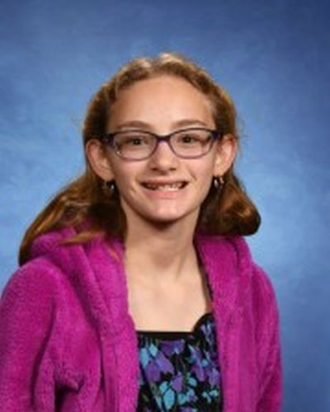
Kathryn Riffell - Nominated by Mrs. Estes
I have chosen Kathryn Riffell as this month’s Student Spotlight because she is a very compassionate, considerate, hardworking student that follows all my expectations in class. She tries very hard on everything she does in my class. She listens during instruction and demonstrations. She is kind and considerate of others. Kathryn has a positive outlook and is excited to learn new things and never complains. I always see her with a smile on her face. I would call her the ideal student and I enjoy having her in my class. Great Job Kathryn & Congratulations!

Slide 6
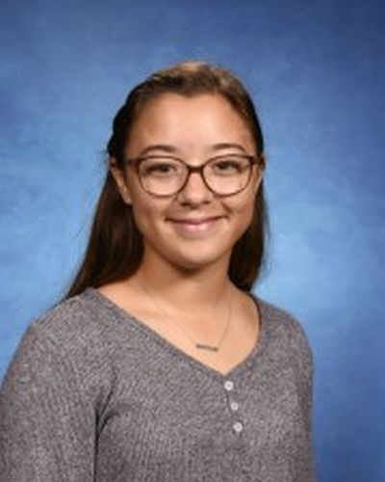
Tegan Canan - Nominated by Mrs. Link
I am nominating Tegan Canan as this month’s Student Spotlight. Tegan always has a smile on her face, even when she claims to be in a bad mood. She always asks how people are doing, and unlike many other people who use it as a simple greeting, she will take the time and have a conversation with you about what is going on in your life. There have been multiple times throughout these last three years where Tegan has sent me an email telling me that I am doing a good job, or even one simply trying to make me feel better after having a rough day. She is always willing to help out her classmates, and it is clear her classmates respect her and her opinion. Tegan is one of the hardest workers I have seen. She is always getting her work done, and is one of the only students I have ever encountered who will keep up with her classwork when she is not in class. Tegan is an amazing person and deserving of being recognized. Great Job Tegan & Congratulations!

Slide 7

Bradford Schools Happenings…

Slide 8
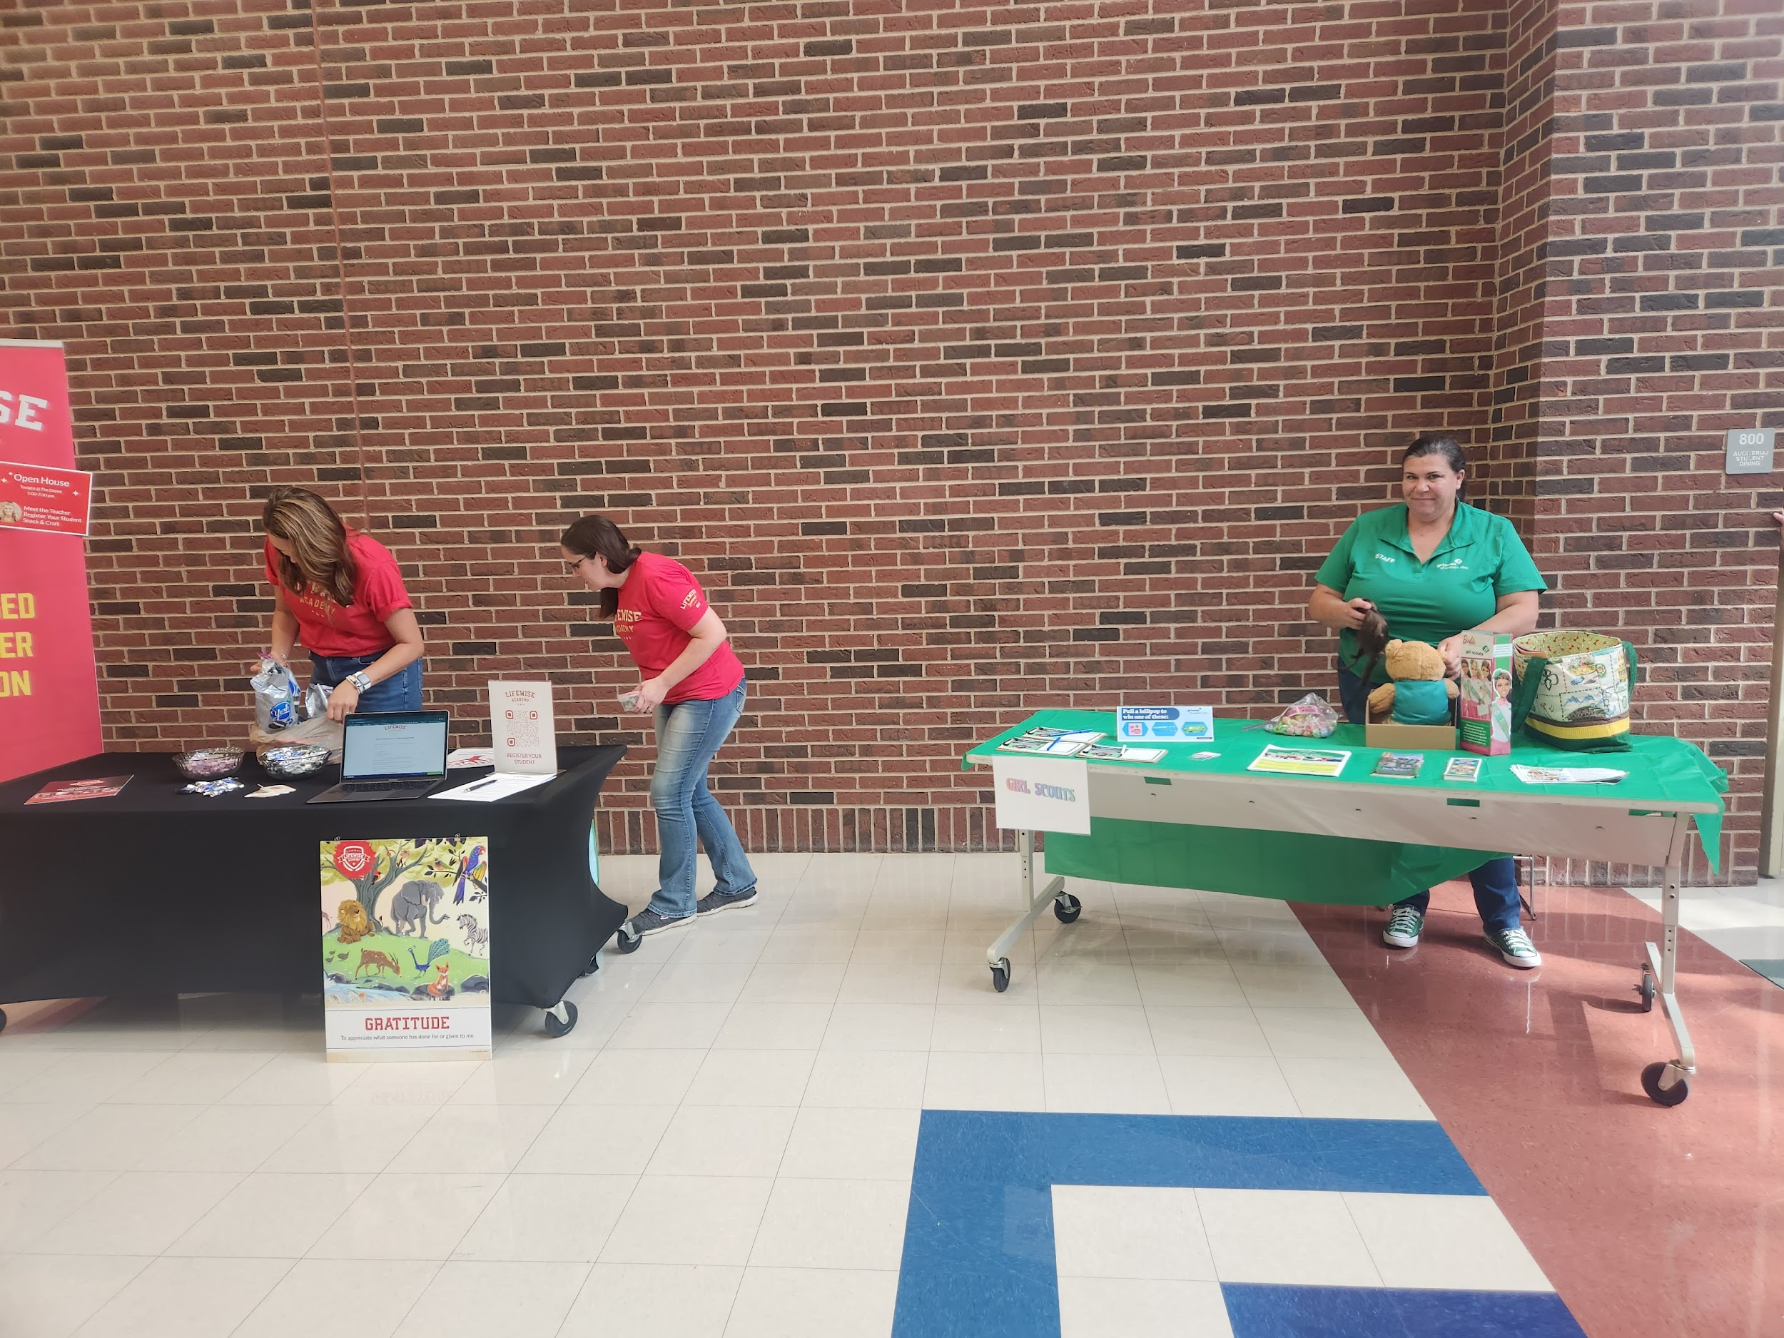
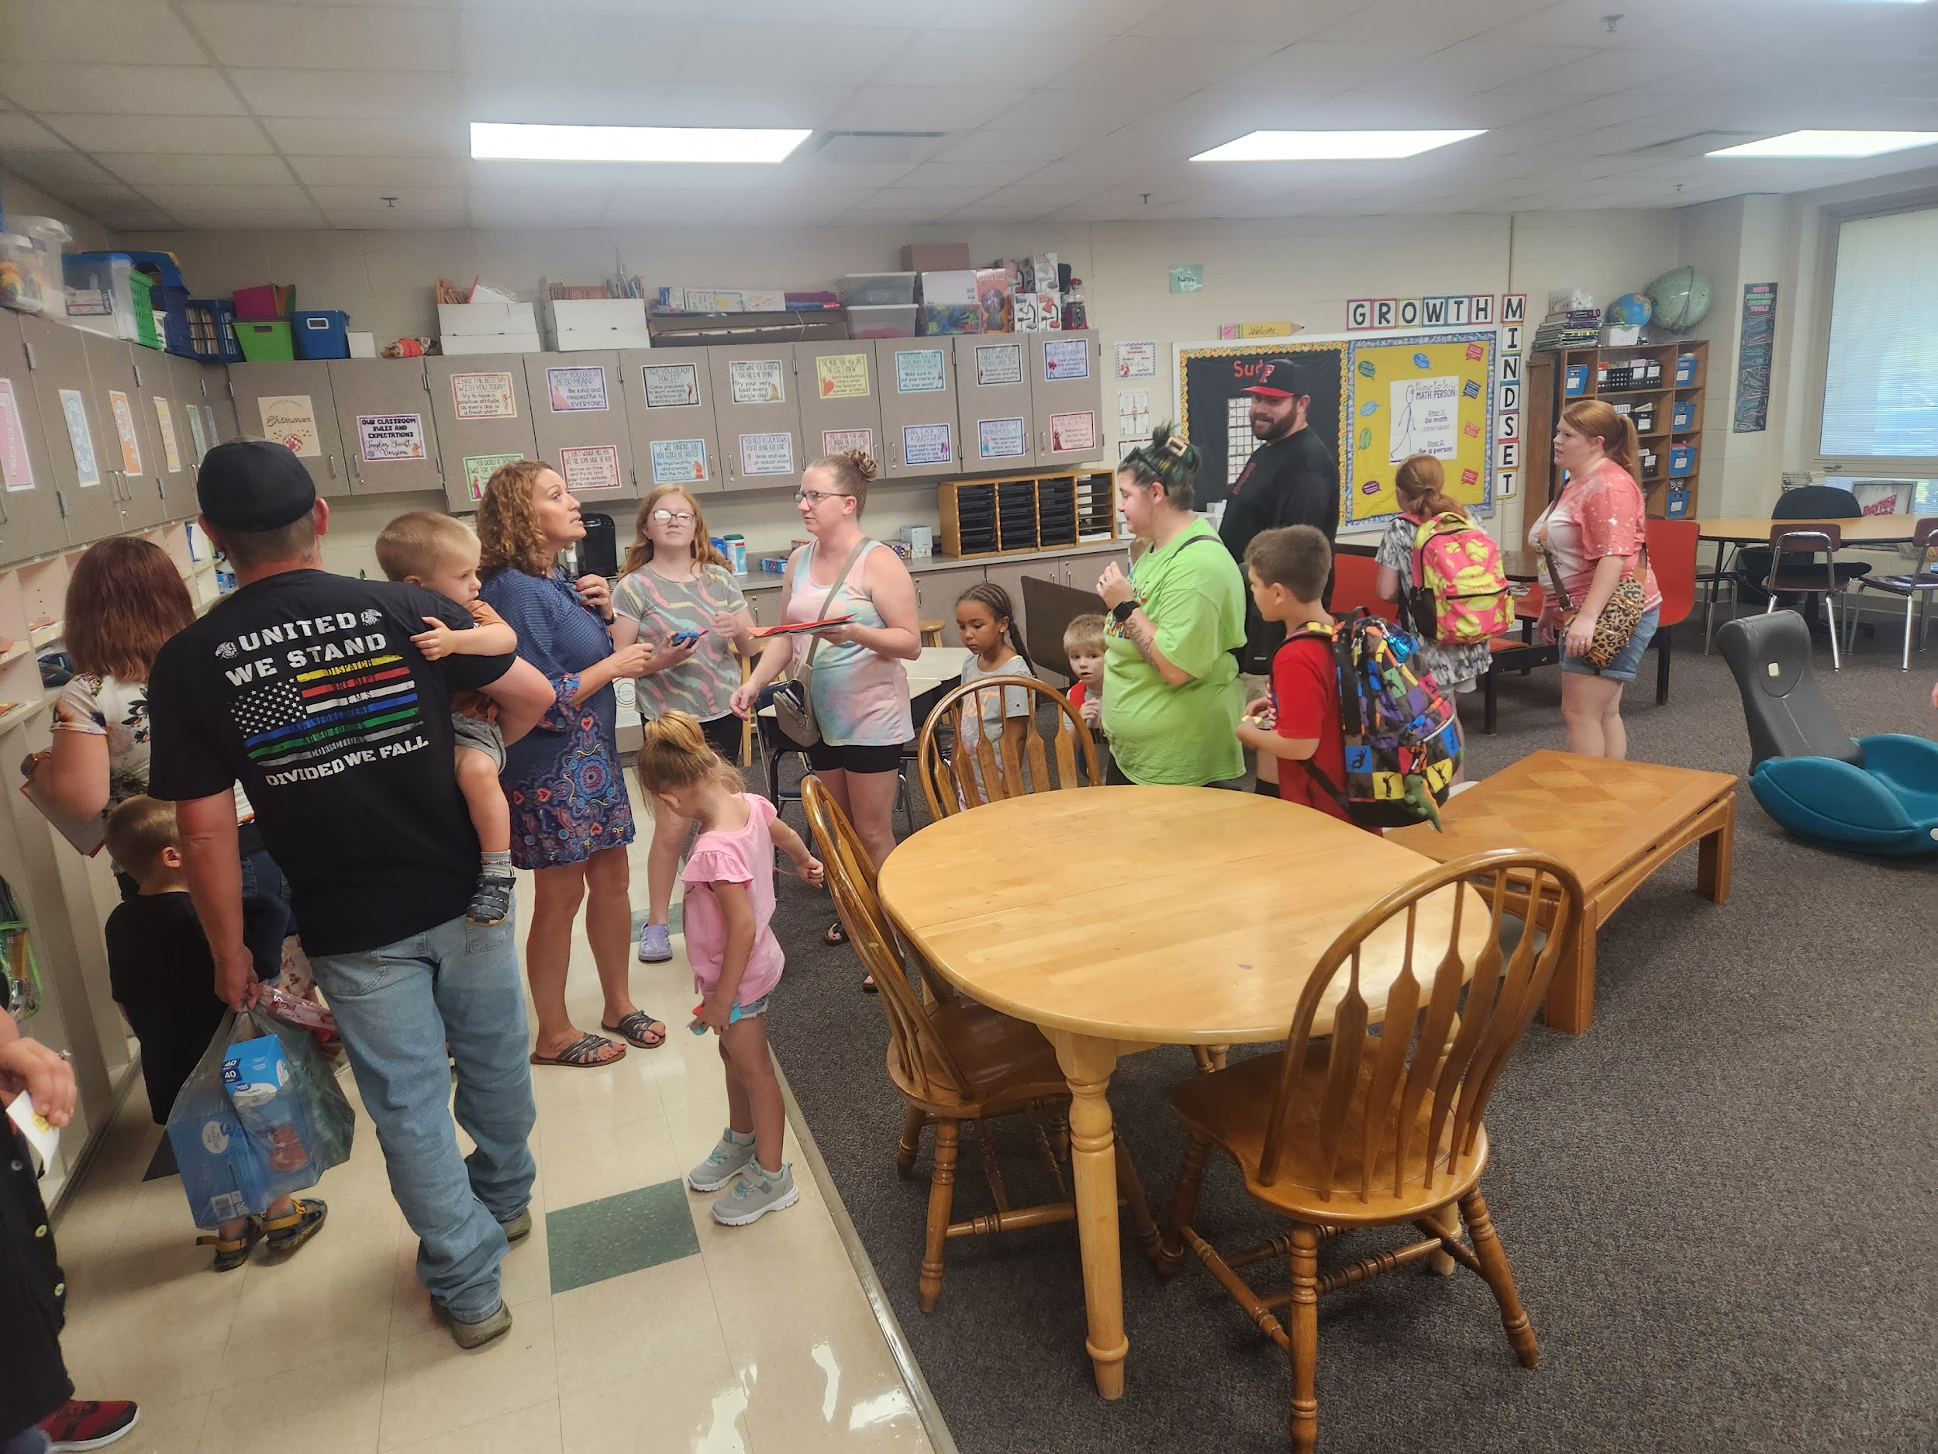
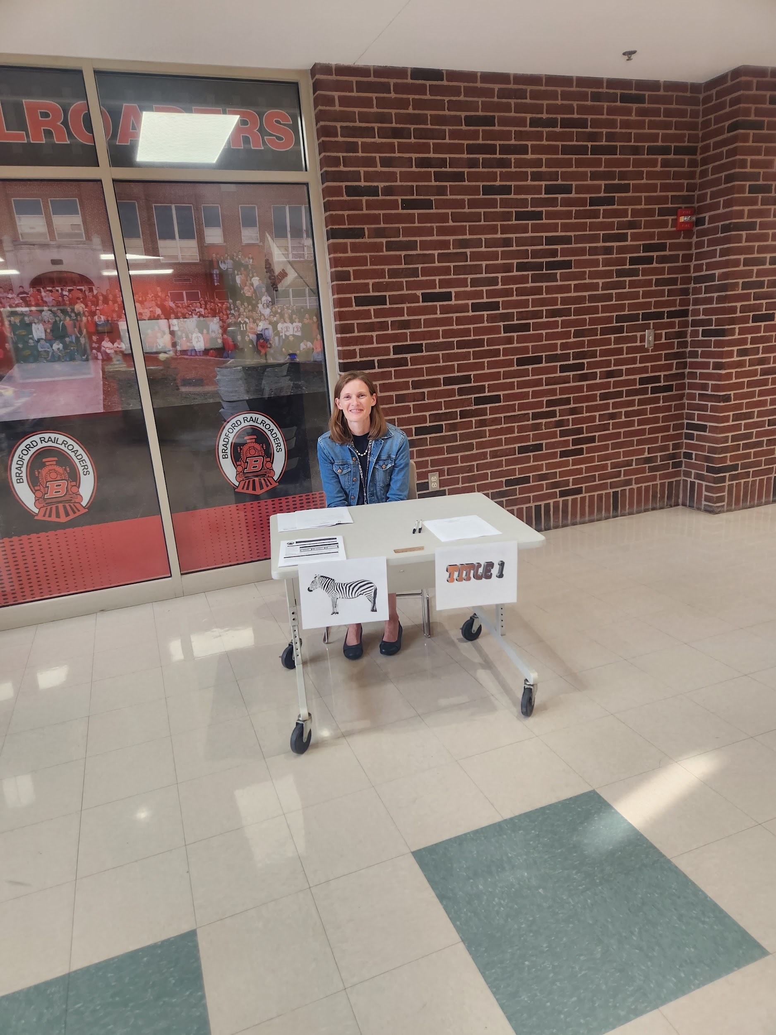
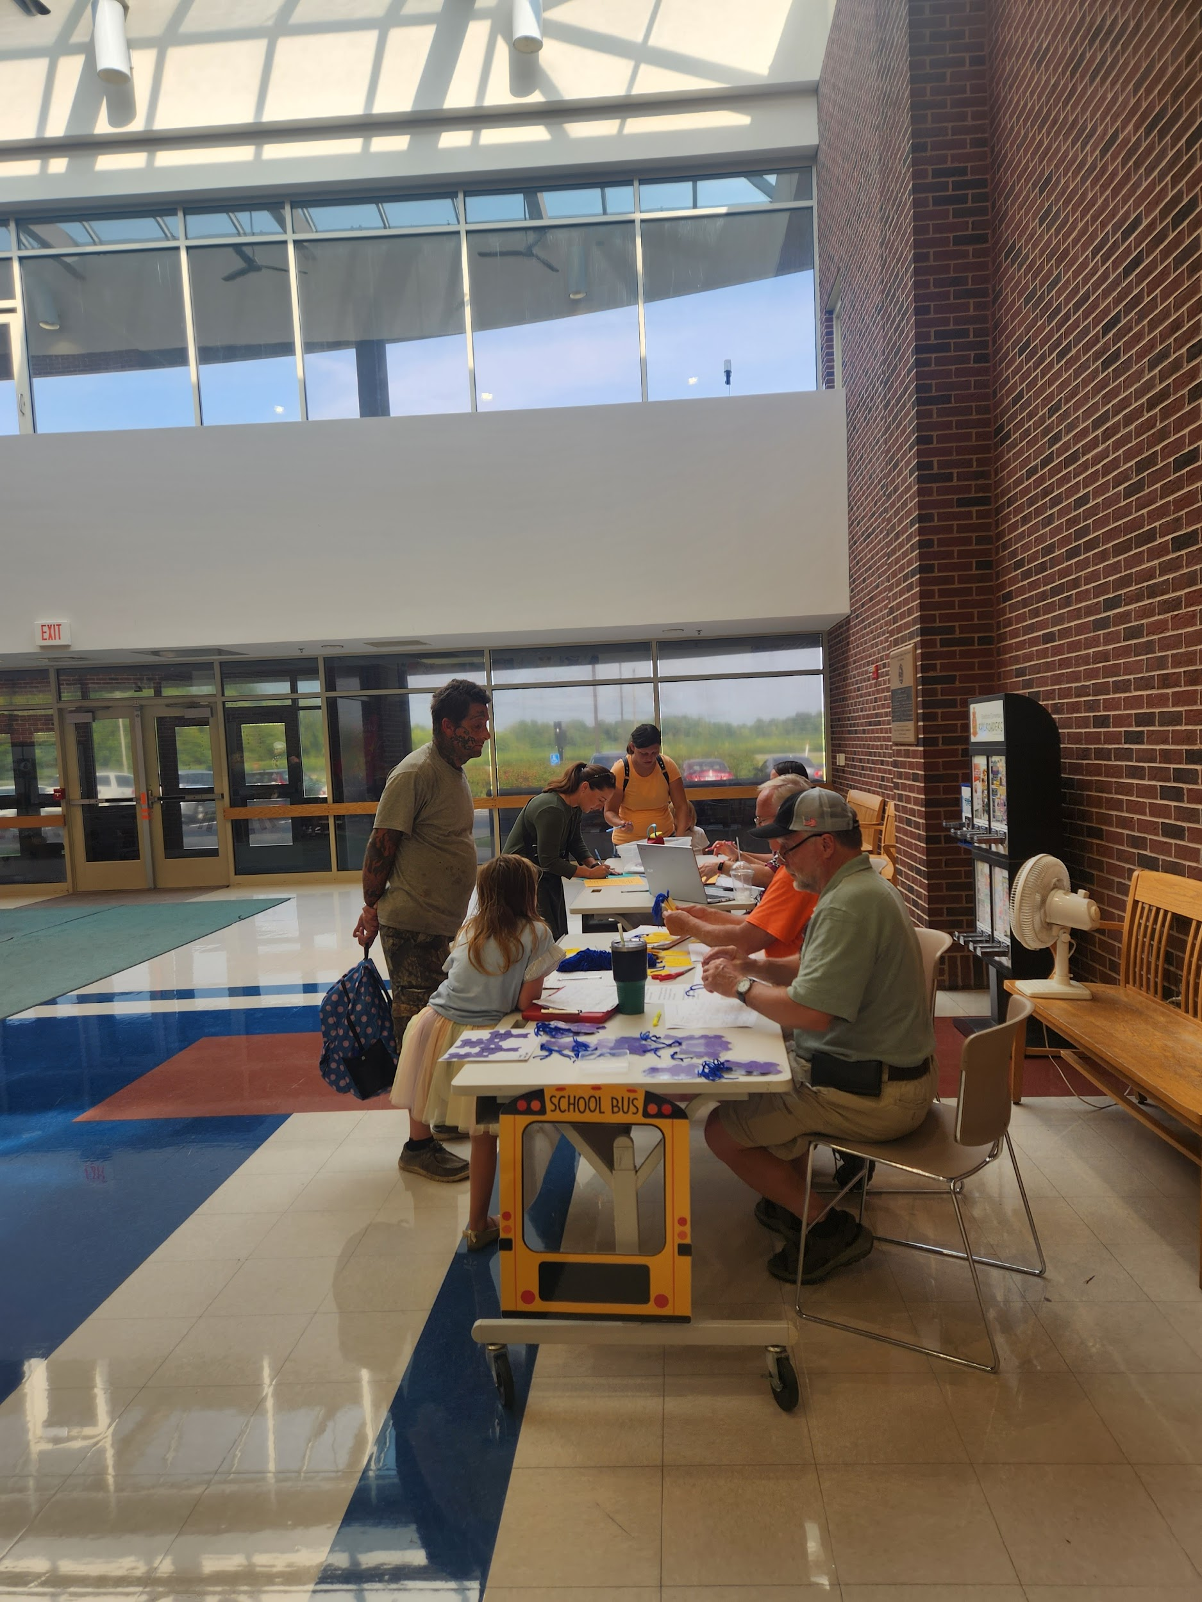
Open House Candids

Slide 9
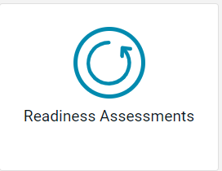
Data
This year our professional development focus is on using data.
We will be utilizing the readiness assessments to help prepare our students for state testing.

Slide 10

Elementary PBIS

Slide 11
2023 Homecoming Court
Queen Candidate King Candidate
Alani Canan Hudson Hill
Tegan Canan Eric Keener
Brooklyn Crickmore Tucker Miller
Savannah Lingo Garrett Trevino
Izabella Painter Landon Wills

Slide 12

FFA - Molly Clark
Communication Proficiency
Only 4 candidates left in the US
Will find out a National Convention in
November what place she comes in.

Slide 13
Upcoming Events
9/20 Darke County Arts in Education Presentation for Grades 4-6
9/20 Farm Science Review
9/22 Gifted PD, ELA and math teachers Grades 3-12
9/25 Kindergarten- Brumbaugh’s Fruit Farm Field Trip- Seasons and life cycles
9/25 1st grade- Miami Co. Park District, Charleston Falls Field Trip- Habitats
10/7 - Homecoming Dance
10/11 No School for Teacher Professional Development
10/13 Pumpkin Show School Parade

Slide 14
Athletic Upcoming Events
9/21 Golf @ WOAC Tourney Richmond Elks, JH VB v Preble Shawnee, HS VB @ Preble Shawnee
9/22 Football @ Dixie
9/23 XC @ Tour de Sewer, JH VB v Versailles, JH FB @ Dixie
9/25 JH VB @ Arcanum, HS VB @ Union City
9/26 Golf @ Sectionals Turtle Creek, HS VB v Arcanum
9/28 HS VB v Mississinawa Valley, JH VB @ Mississinawa Valley, JH FB @ Mississinawa Valley
9/30 XC @ Newton
HOMECOMING WEEK STARTS OCTOBER 2ND

Slide 15
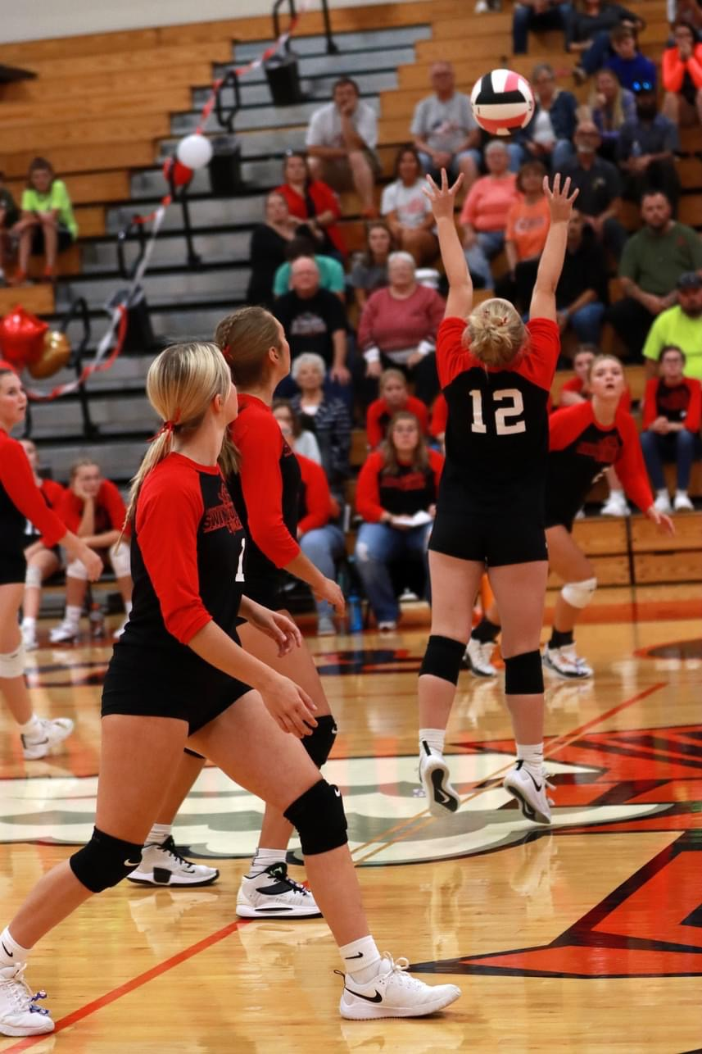
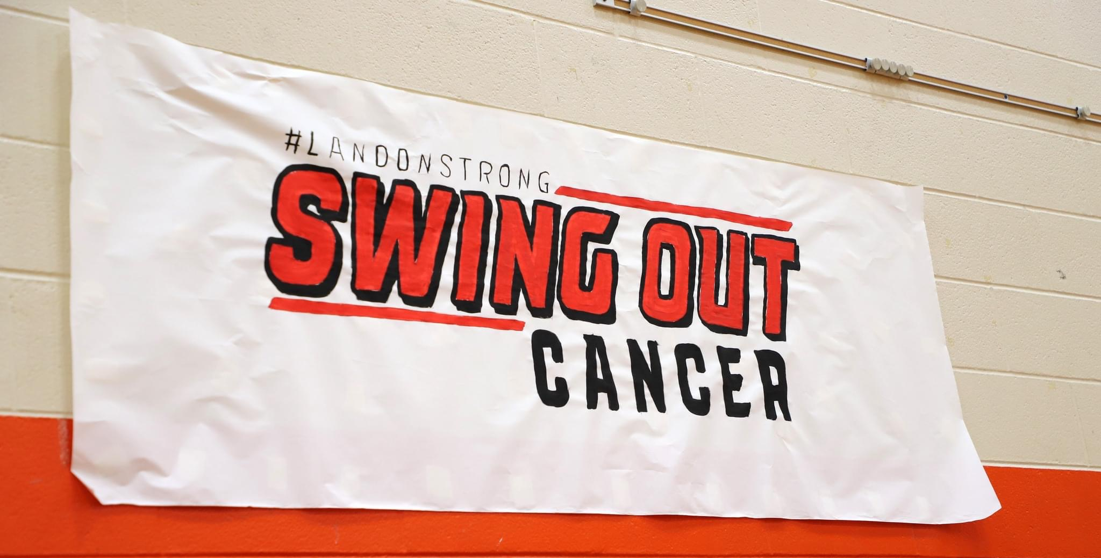
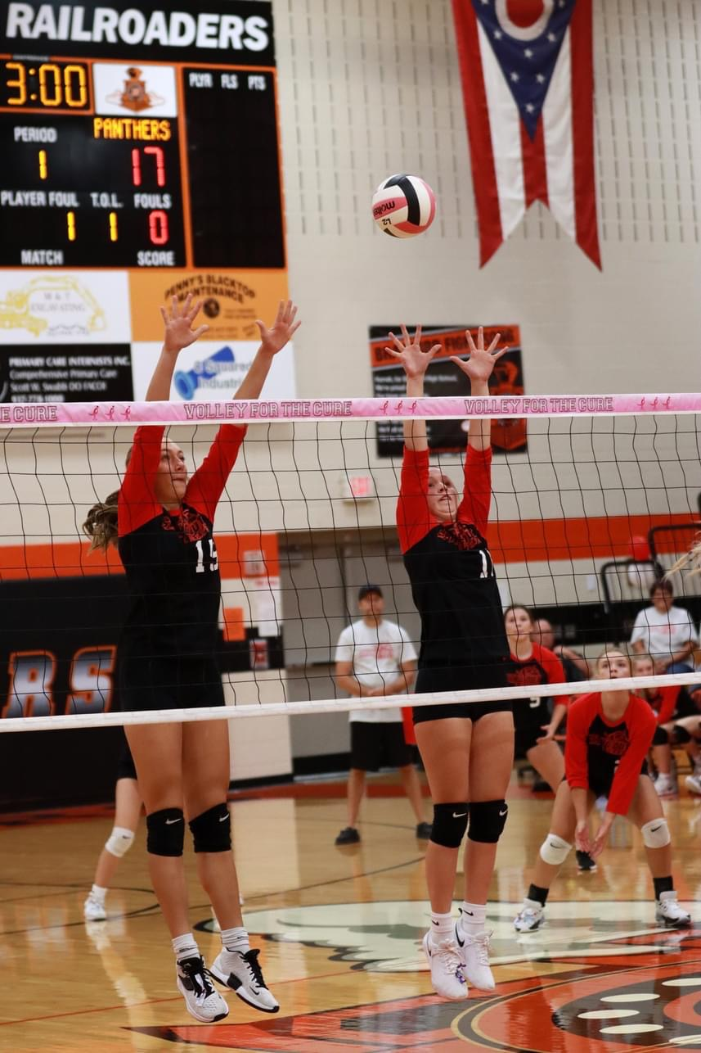
VOLLEY FOR THE CURE: SWINGING OUT CANCER
On 9/14, the Volleyball team hosted Tri County North in a battle against Cancer. The Roaders (both JV and Varsity) came out with Wins and a preliminary donation to the Thobe family of $1390.

Slide 16
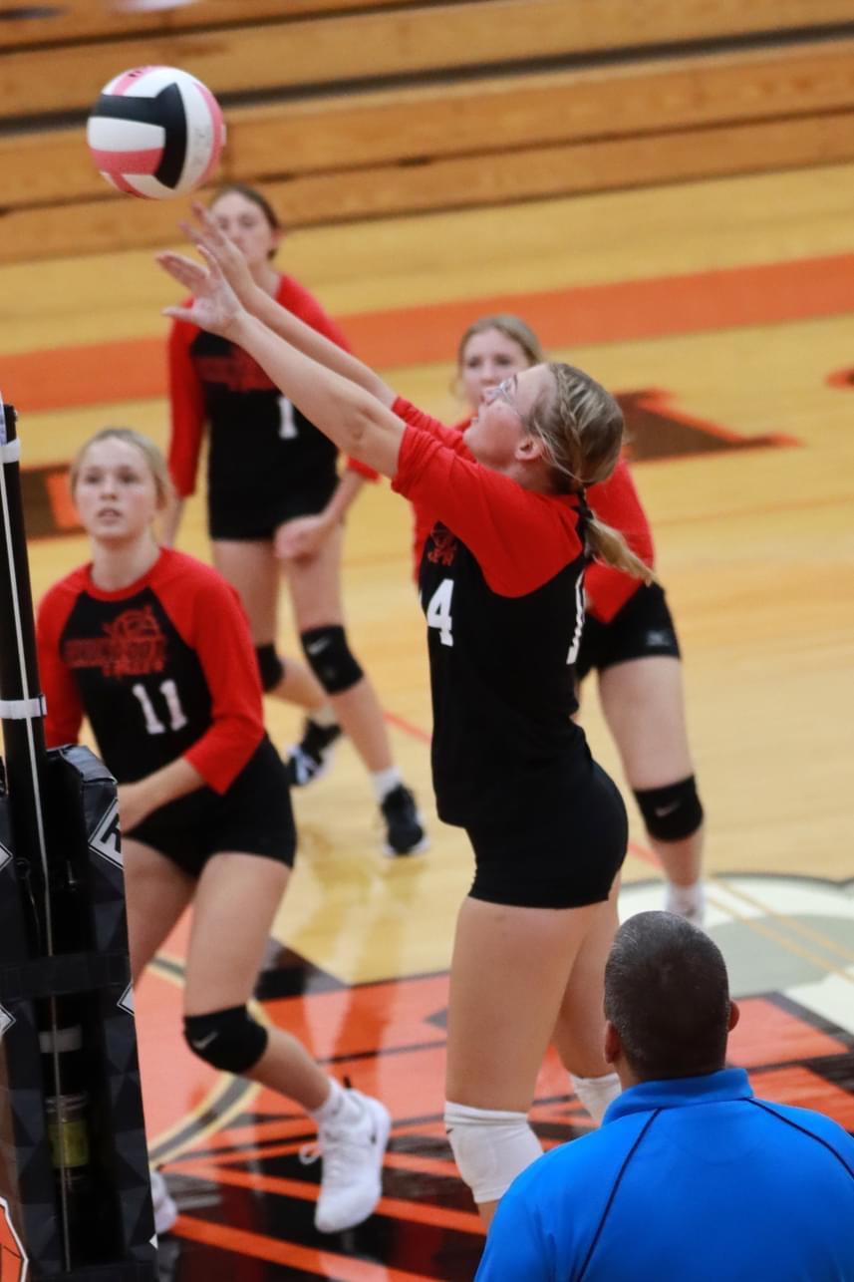
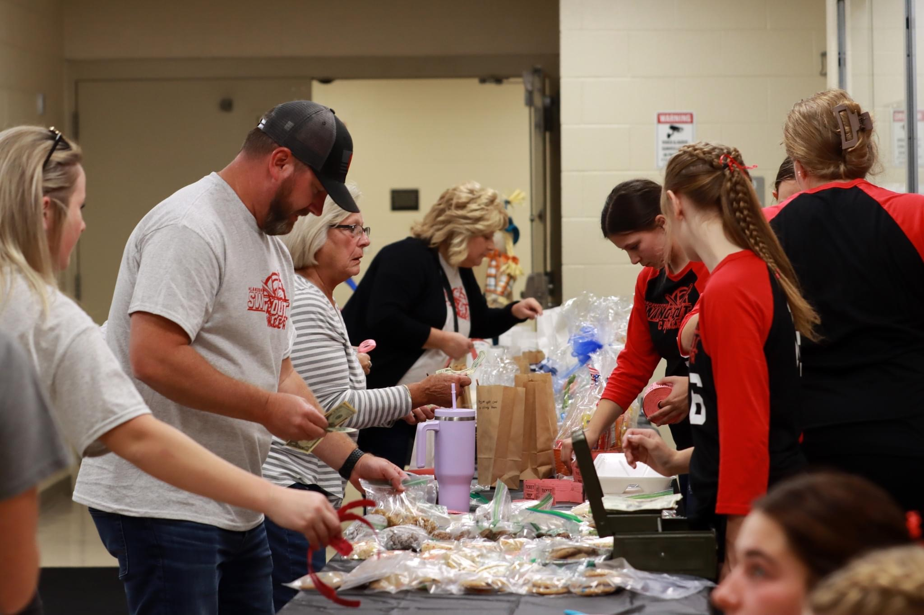
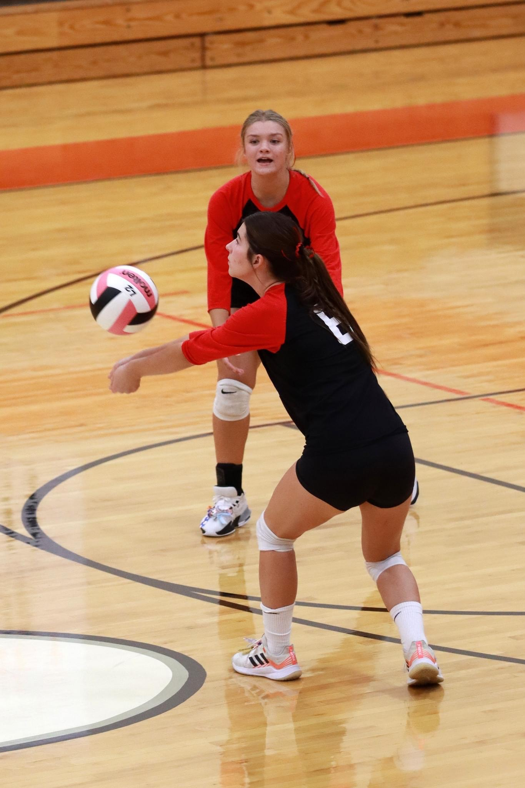
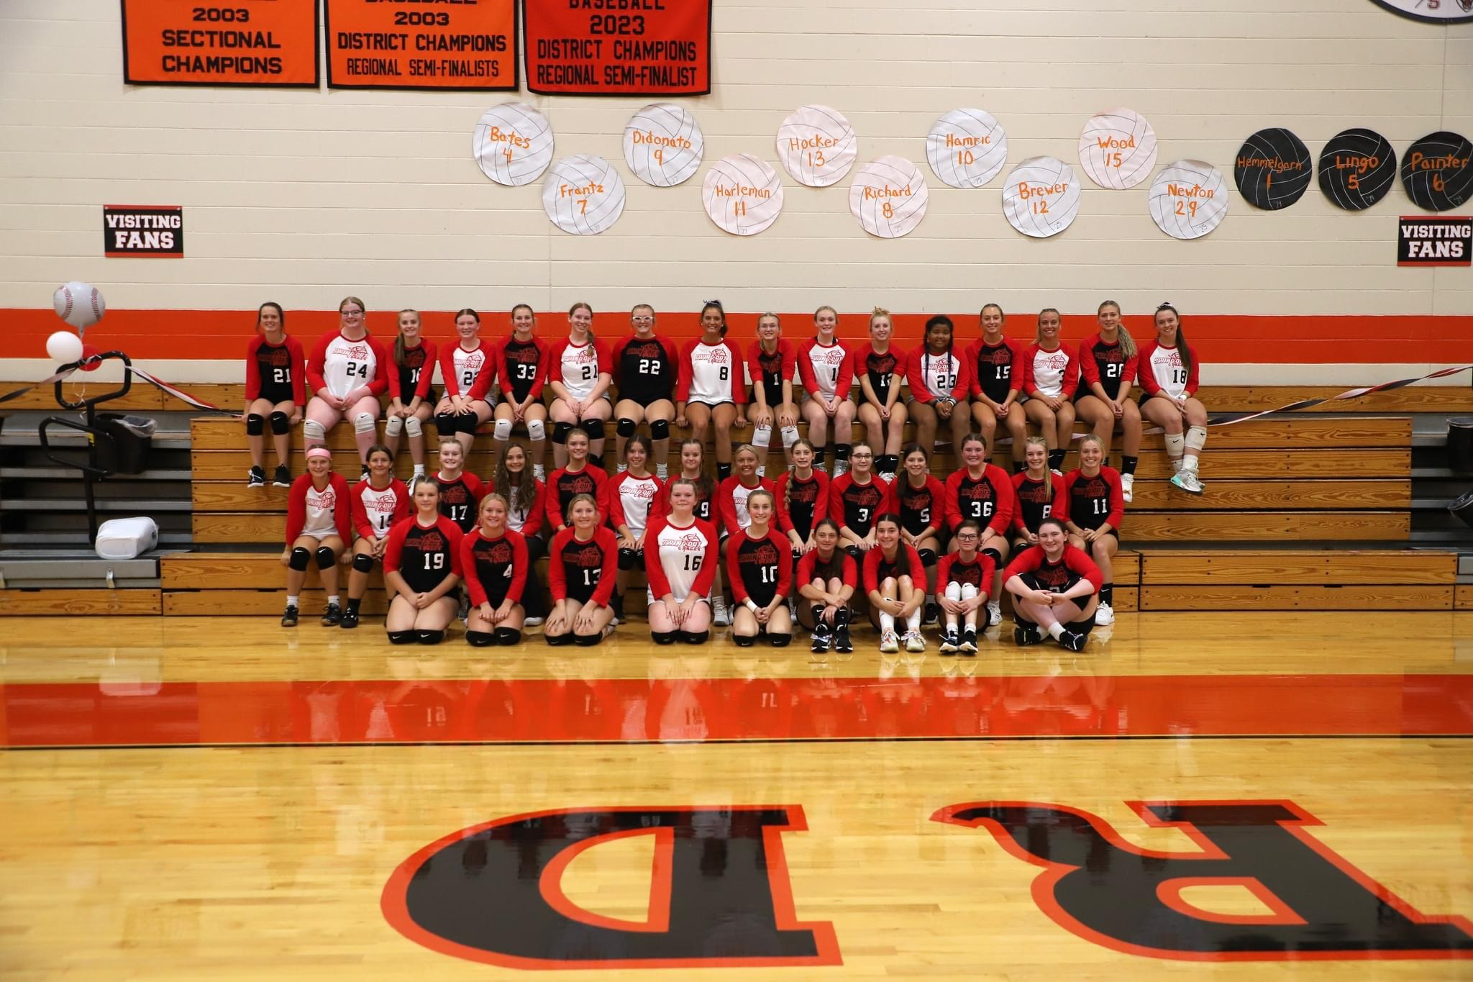
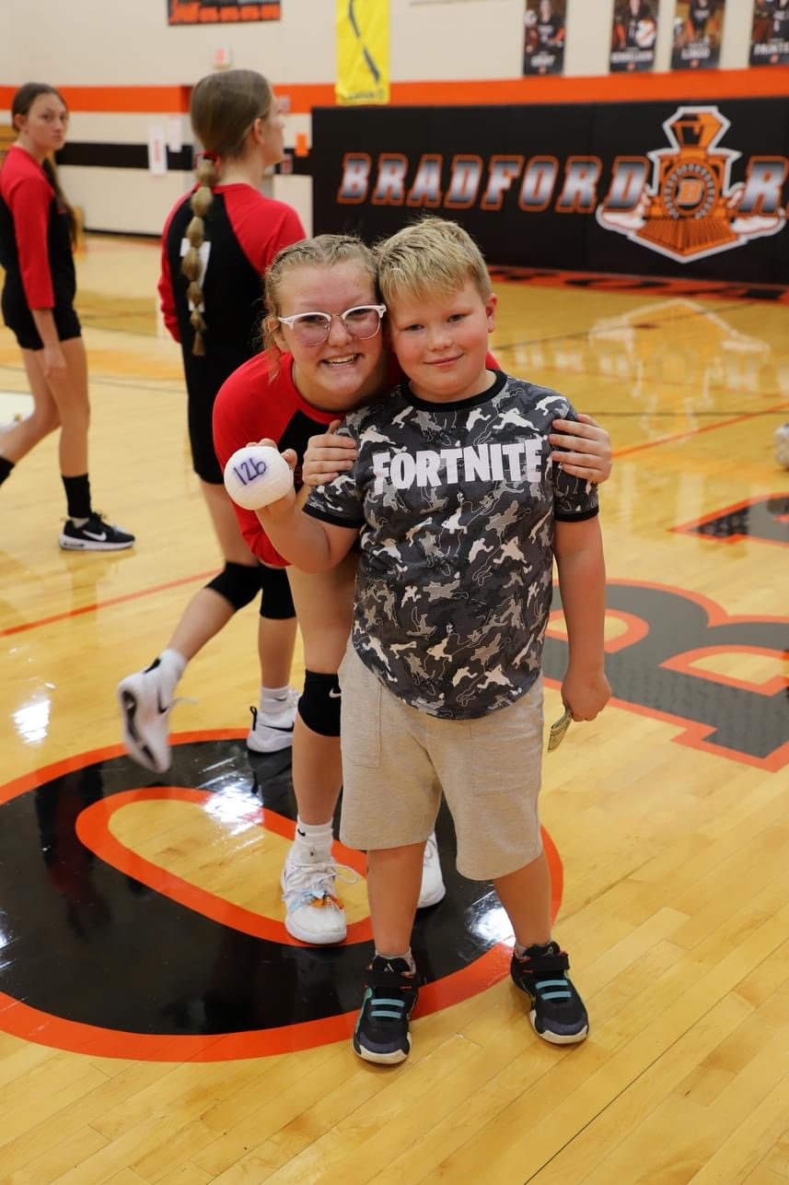
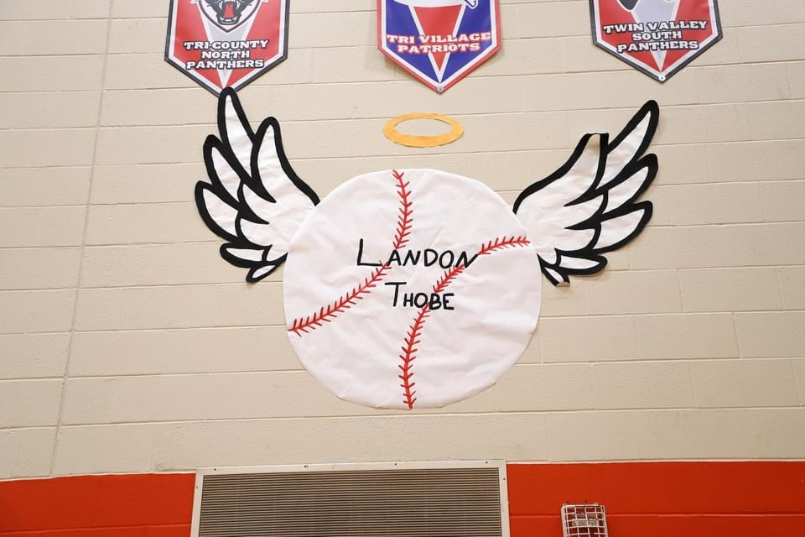
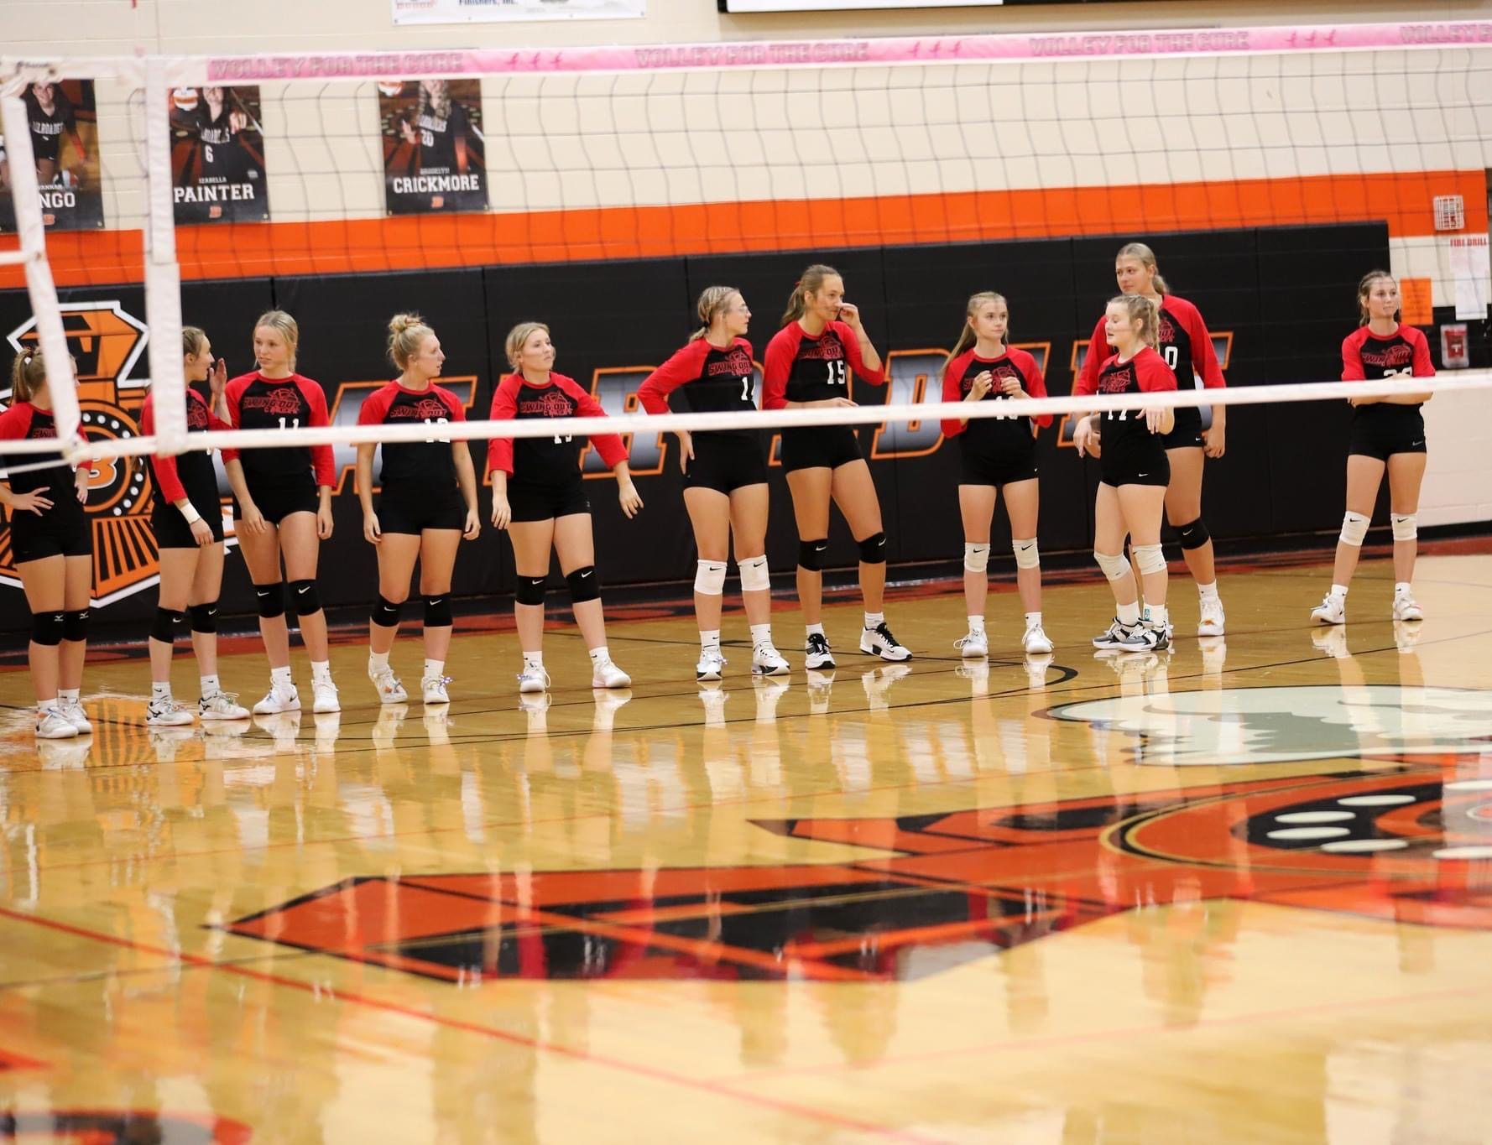
VOLLEY FOR THE CURE: SWINGING OUT CANCER

Slide 17
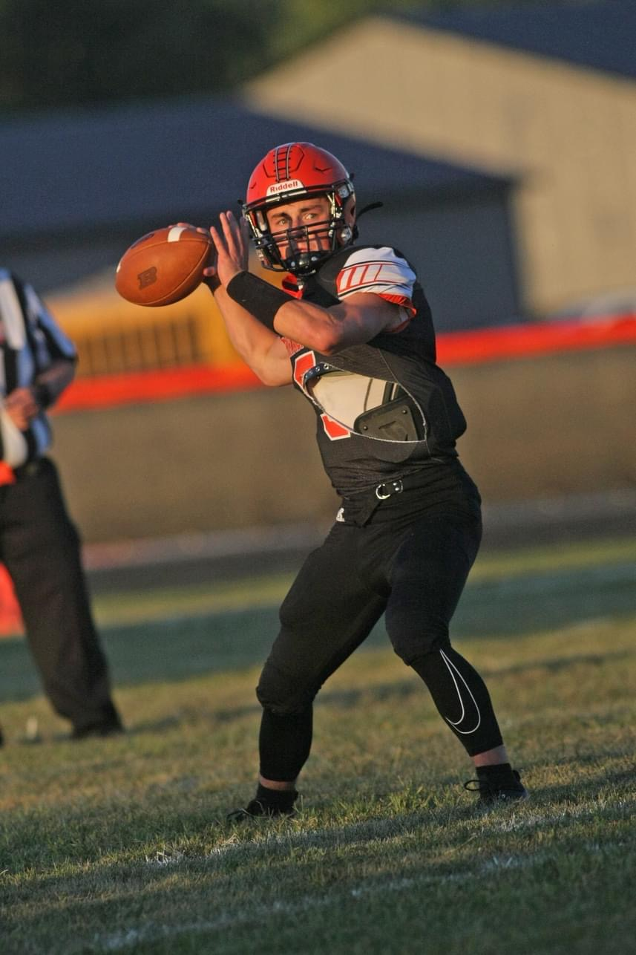
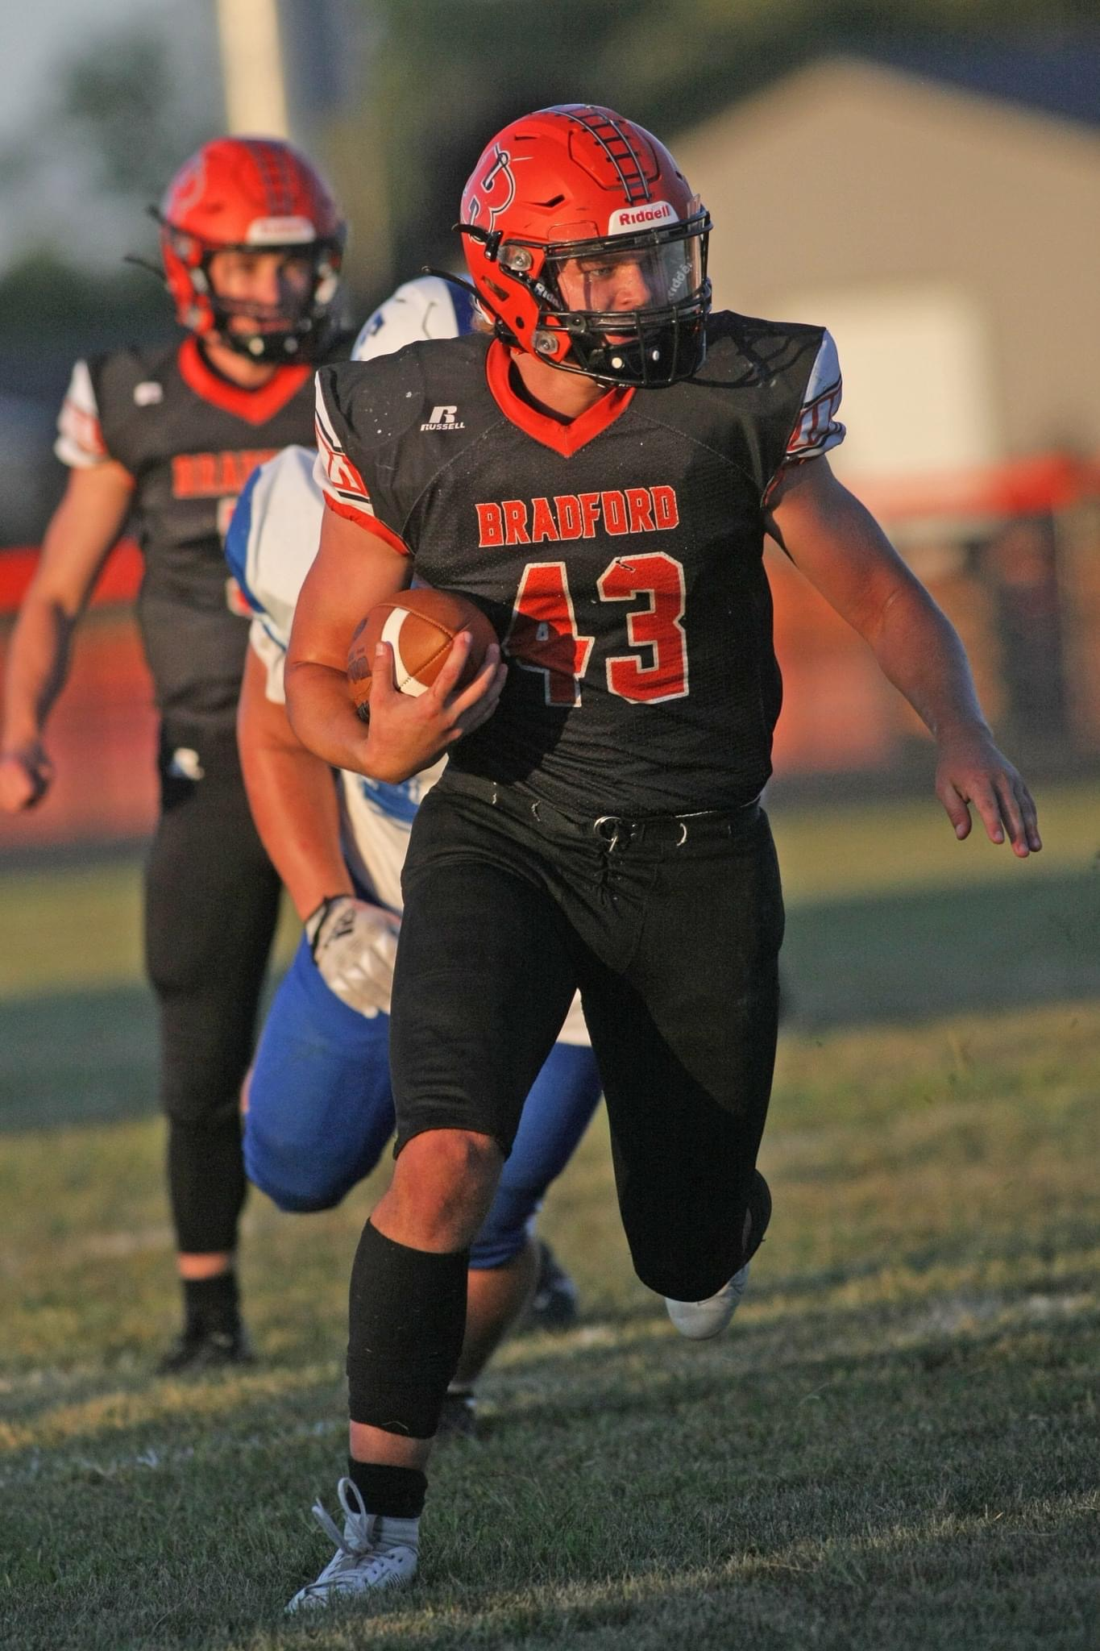
Athletic Updates
Owen Canan:
Daily Advocate Player of the Week
Tucker Miller:
Power 107.1 Blazin Athlete of the Week

Slide 18
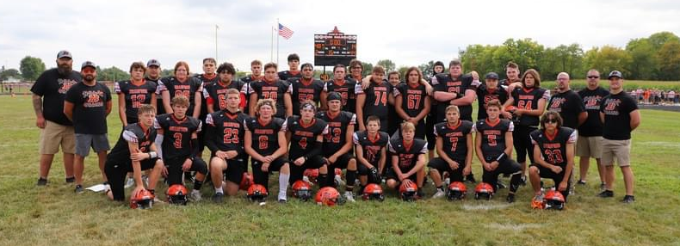
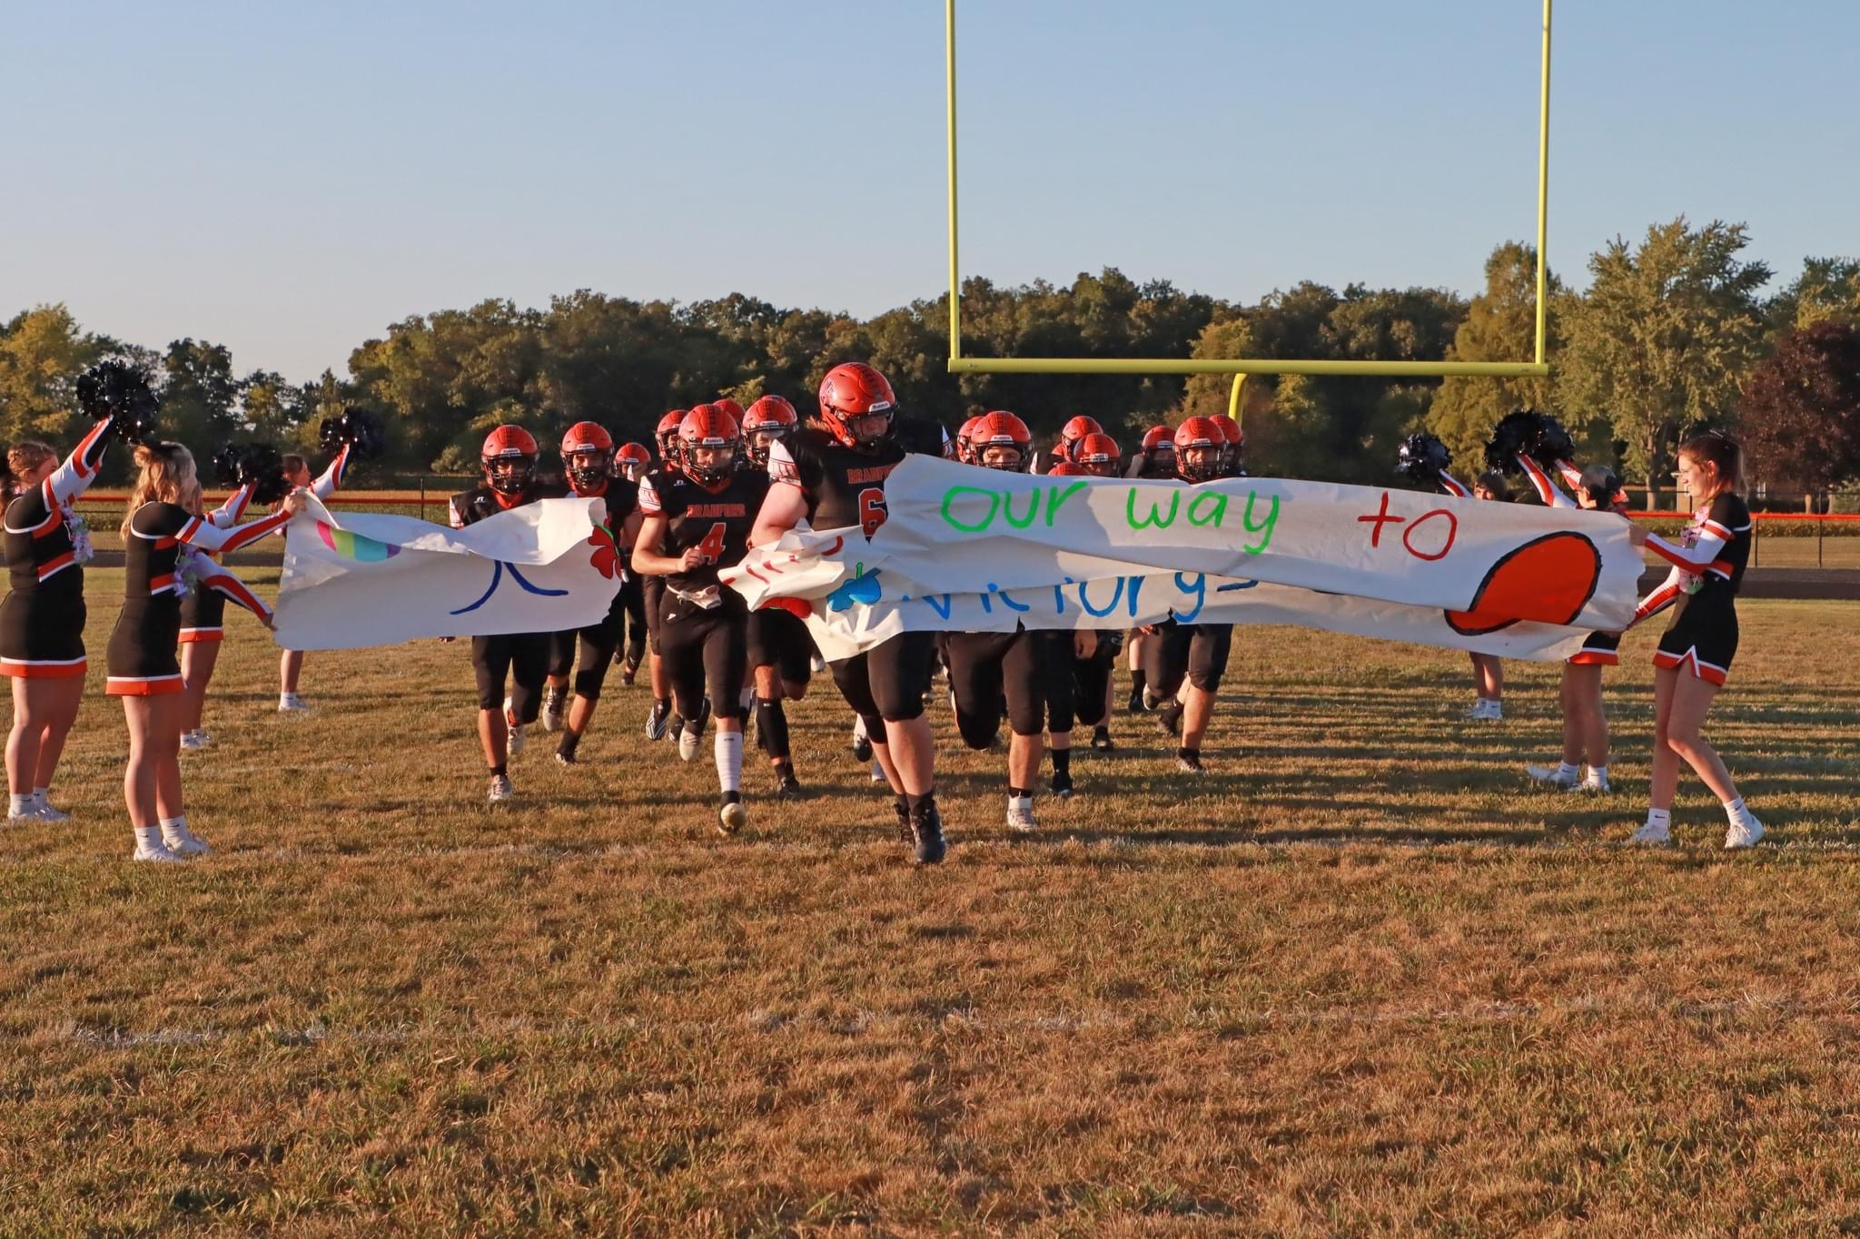
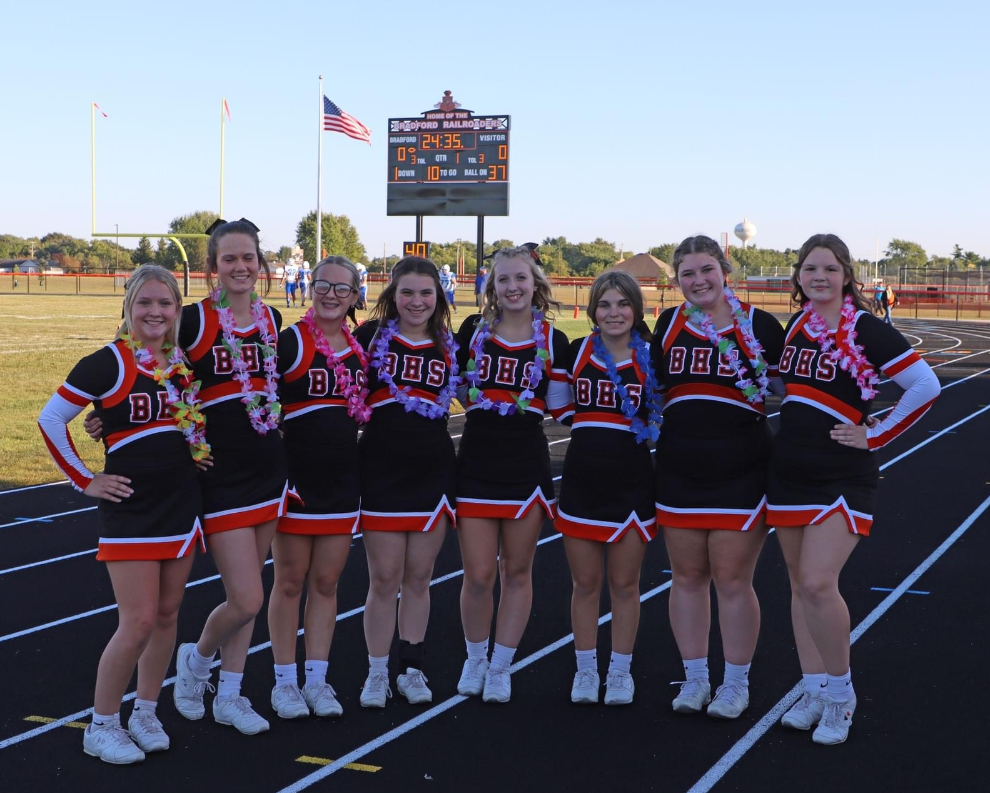
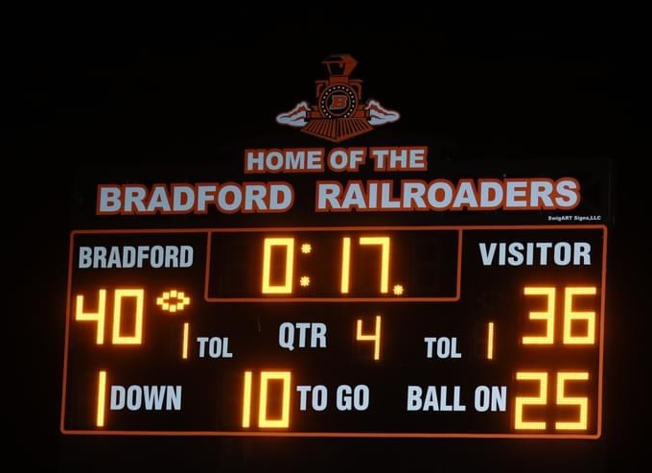
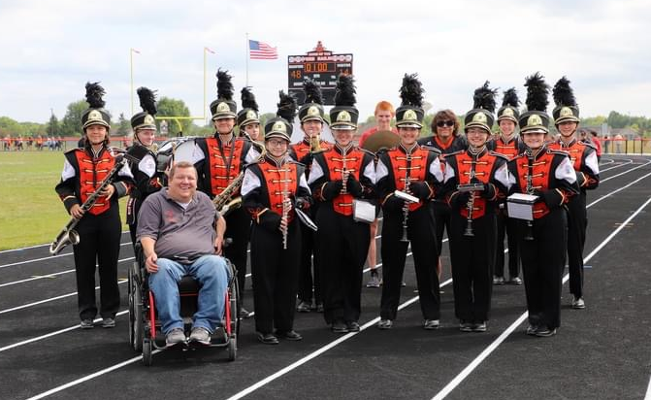
Athletic Updates

Slide 19
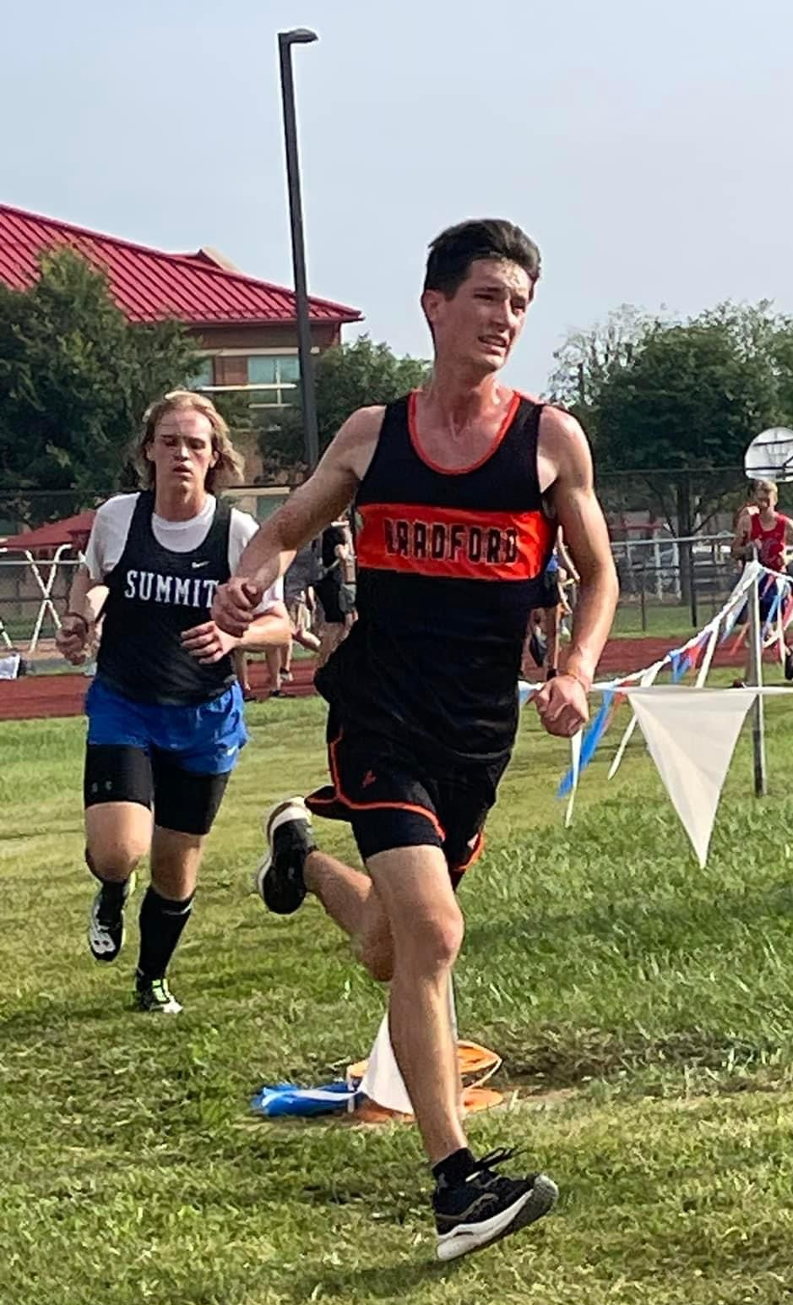
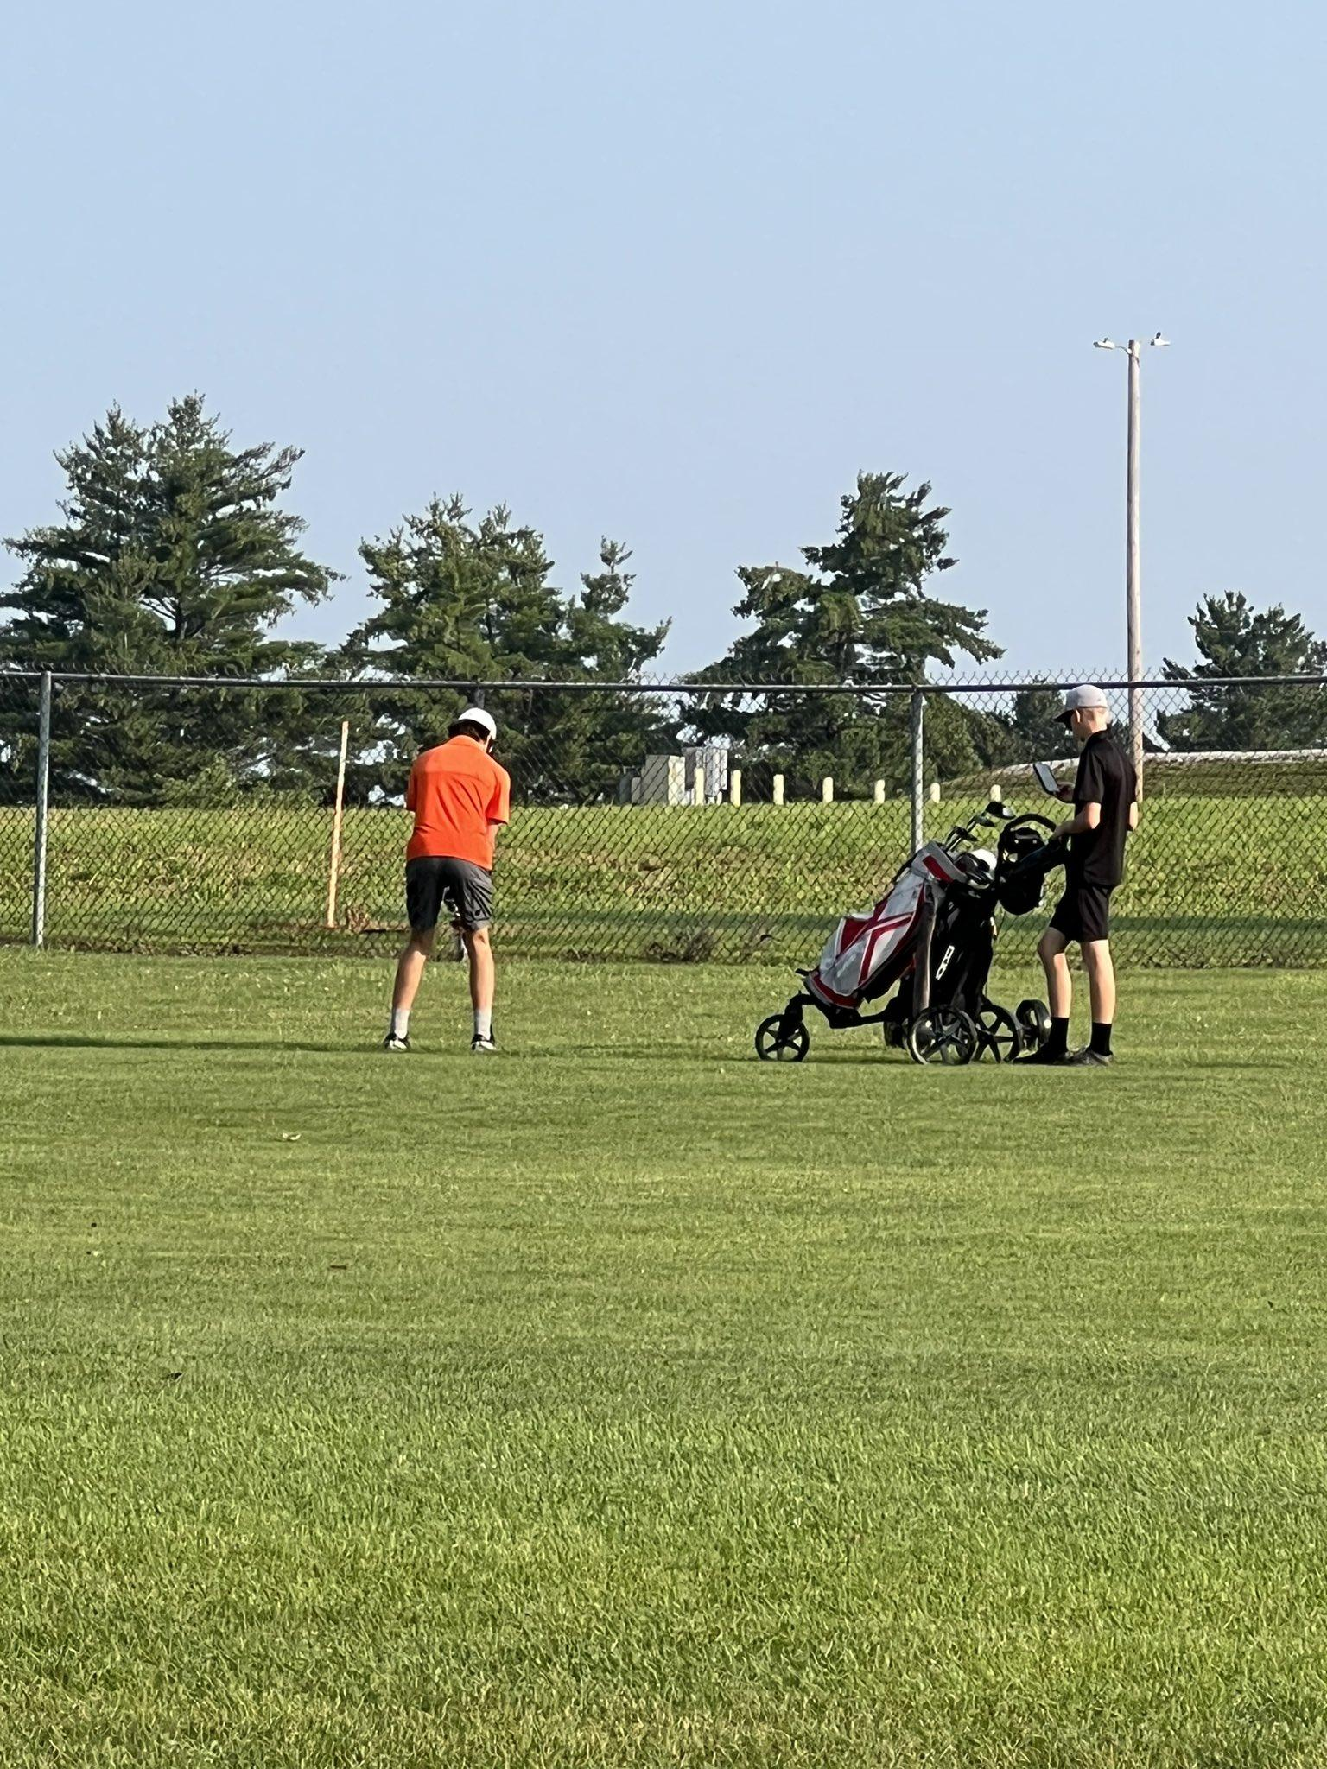
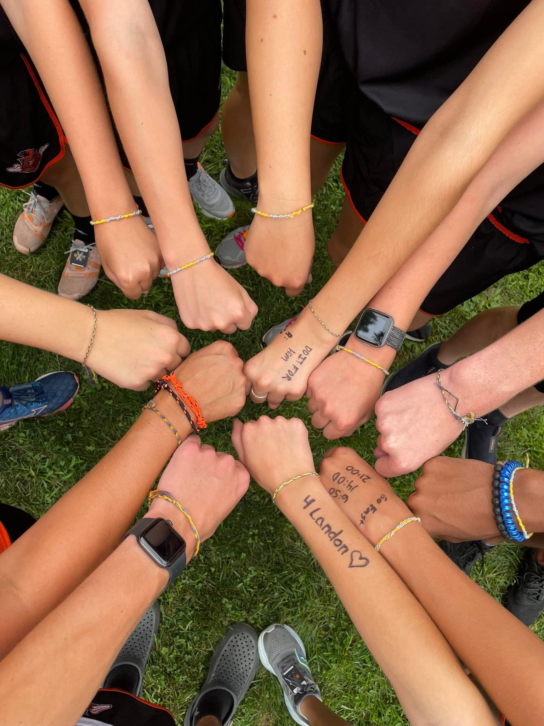
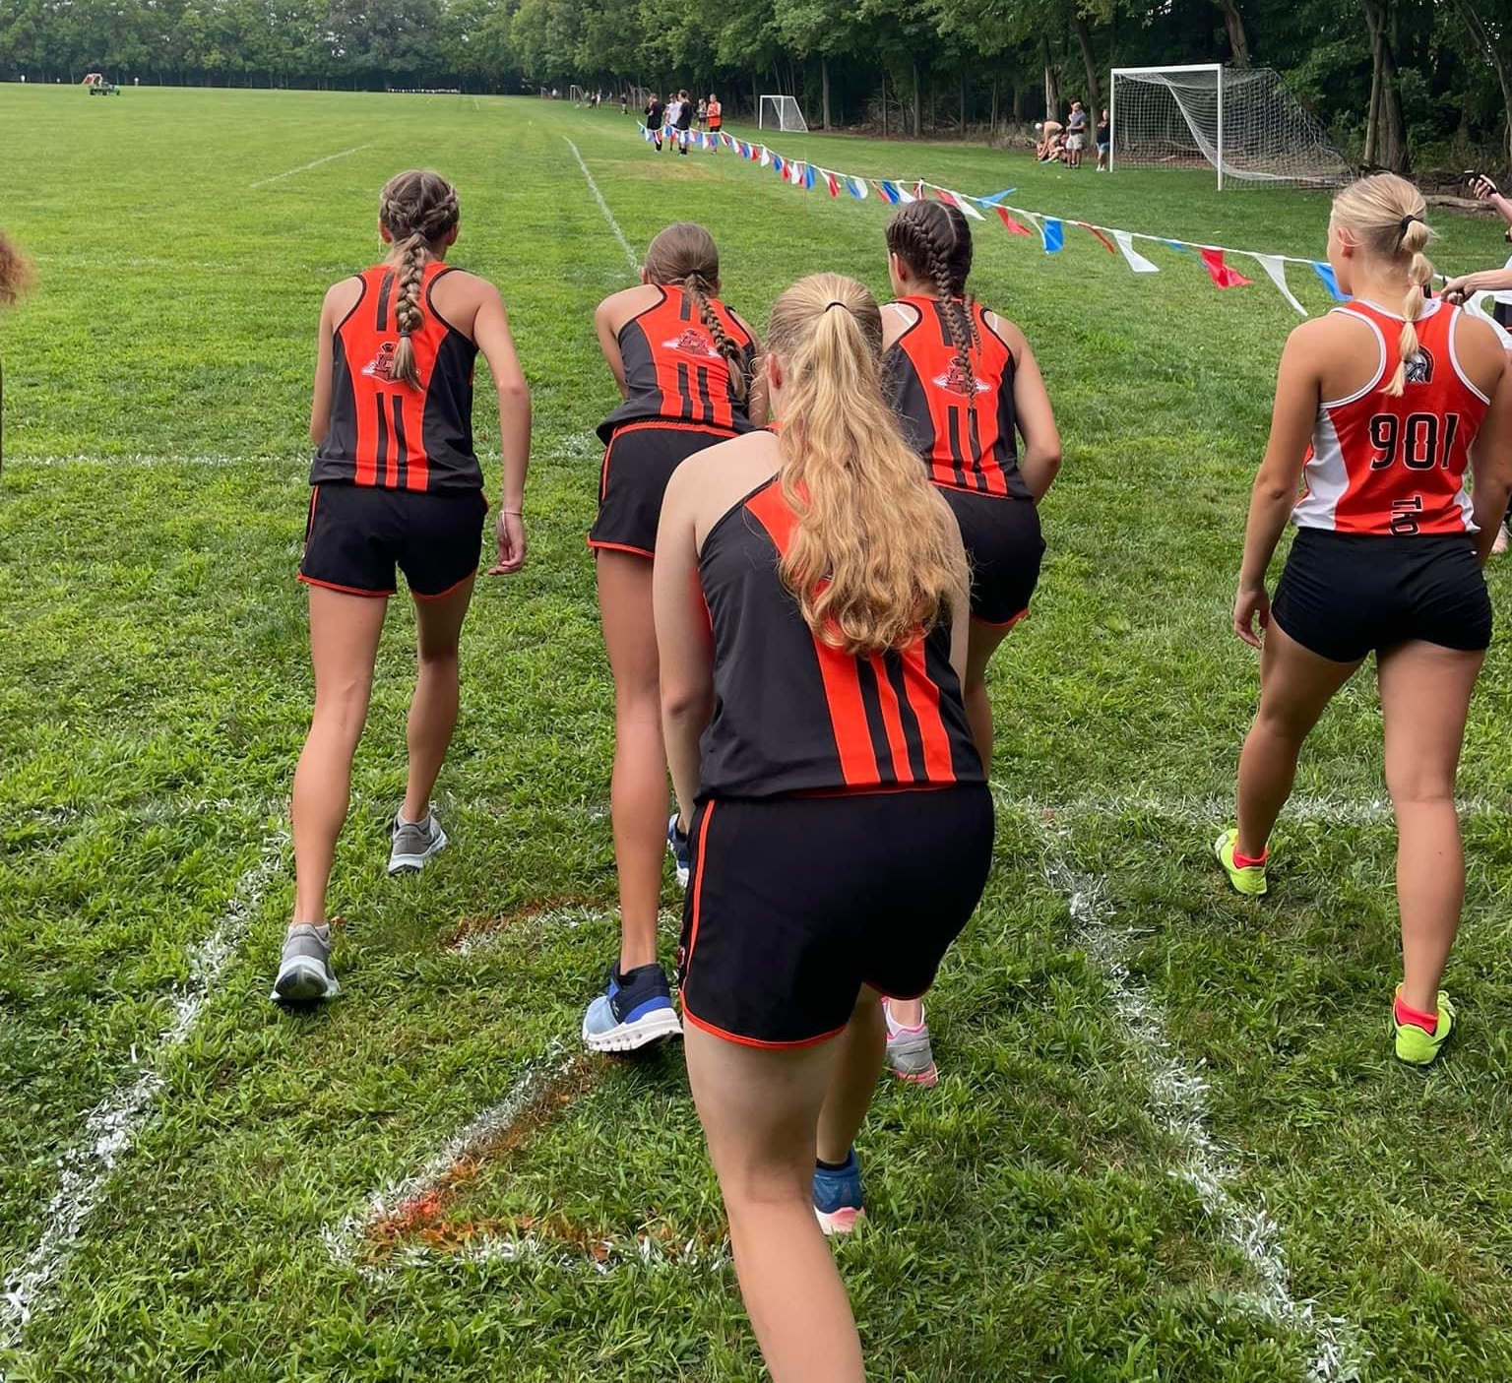
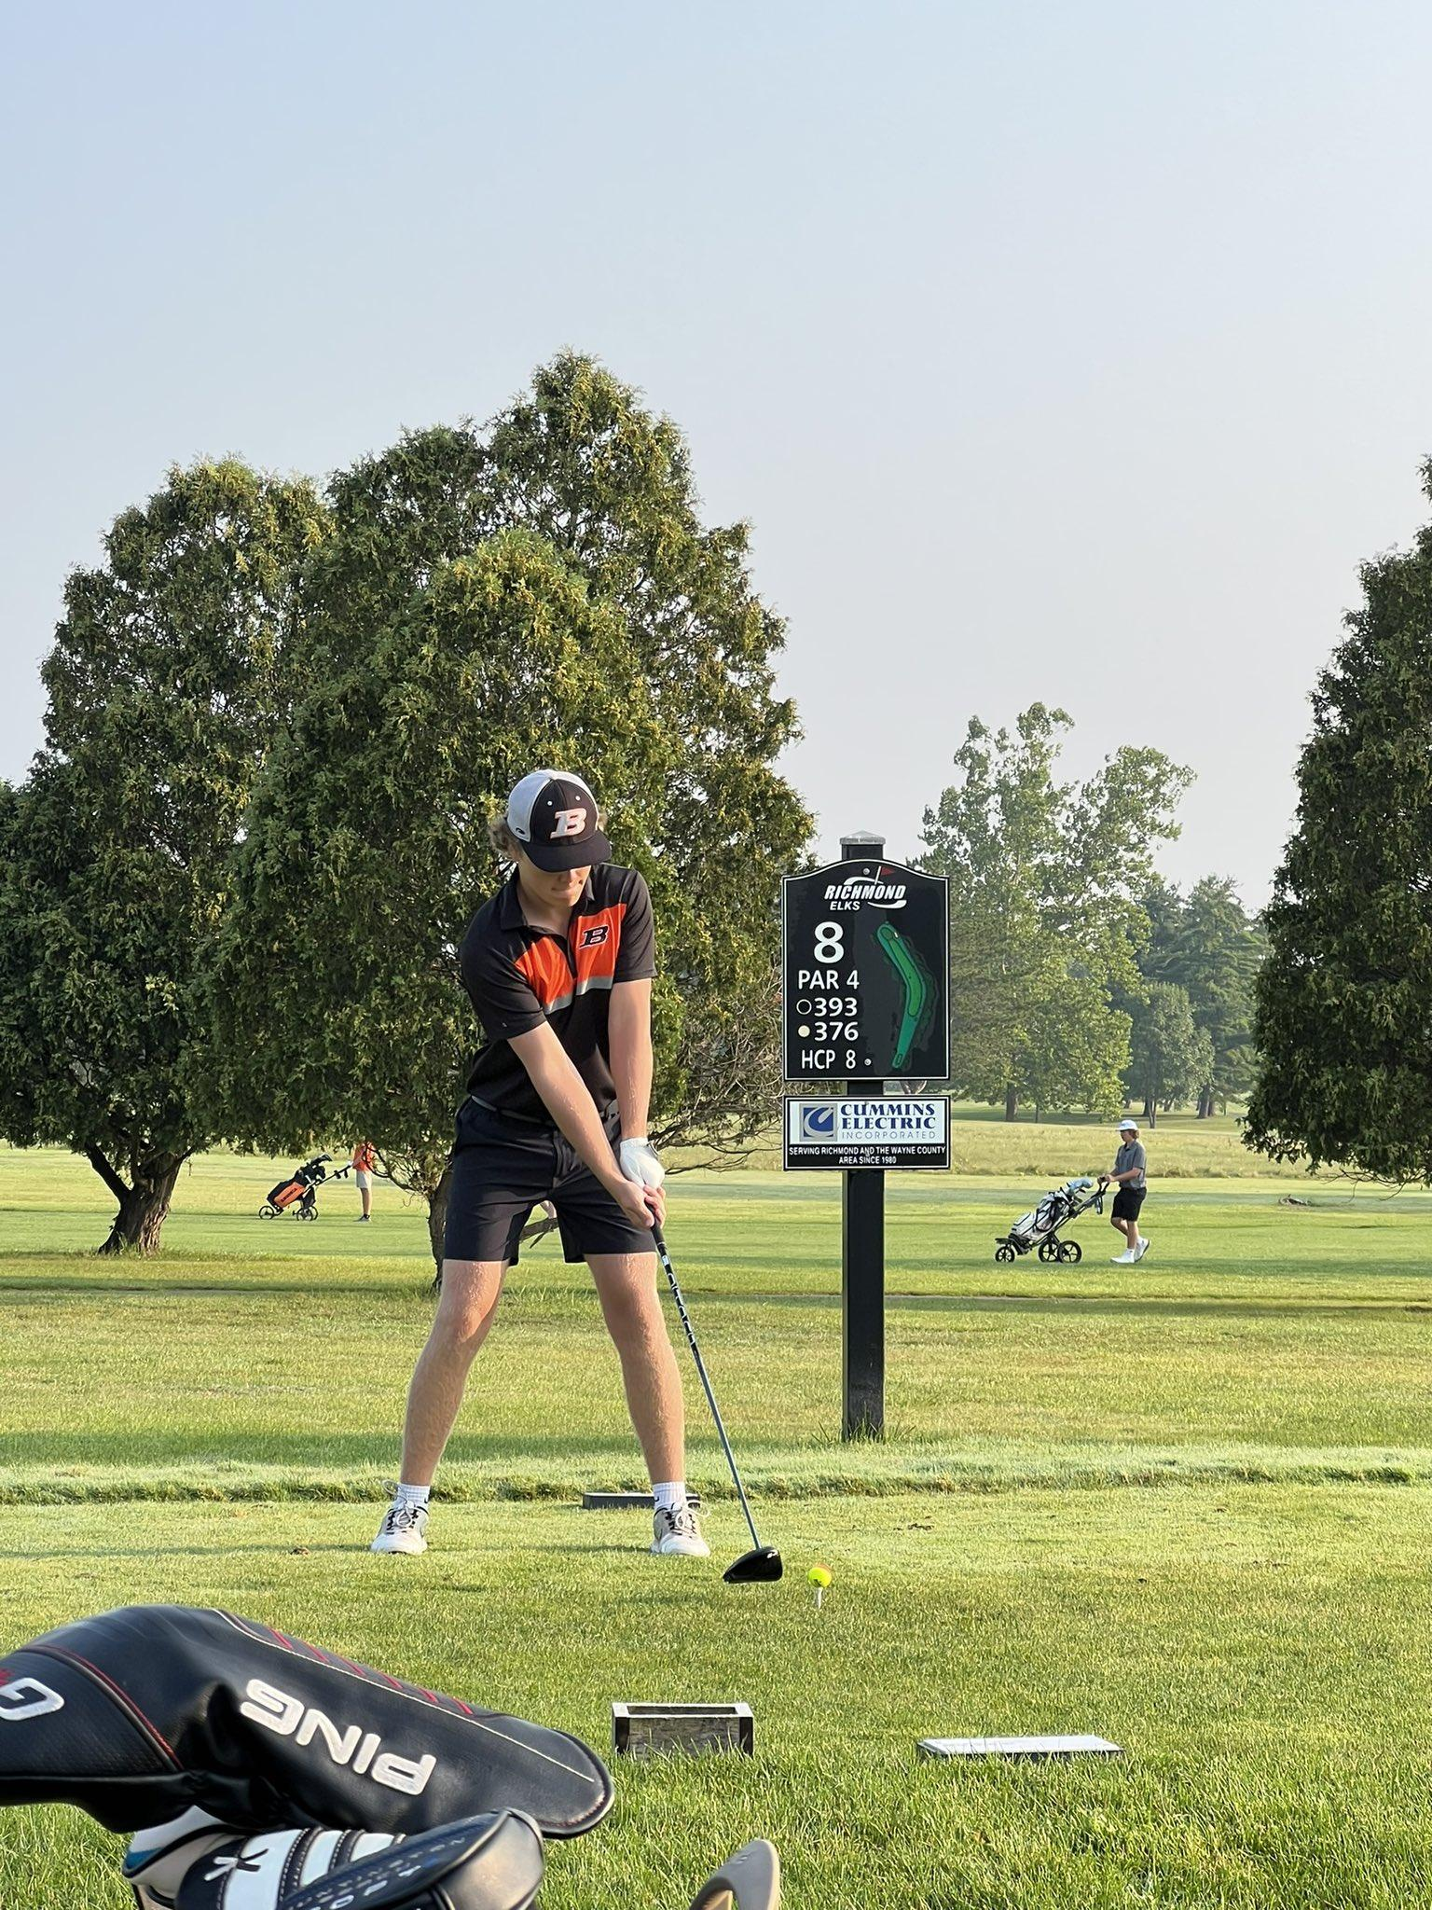
Athletic Updates

Slide 20
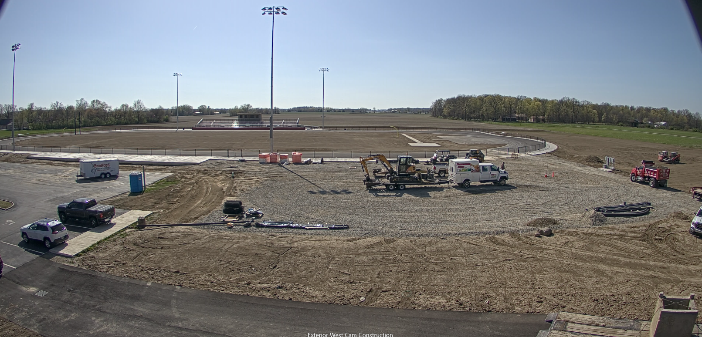
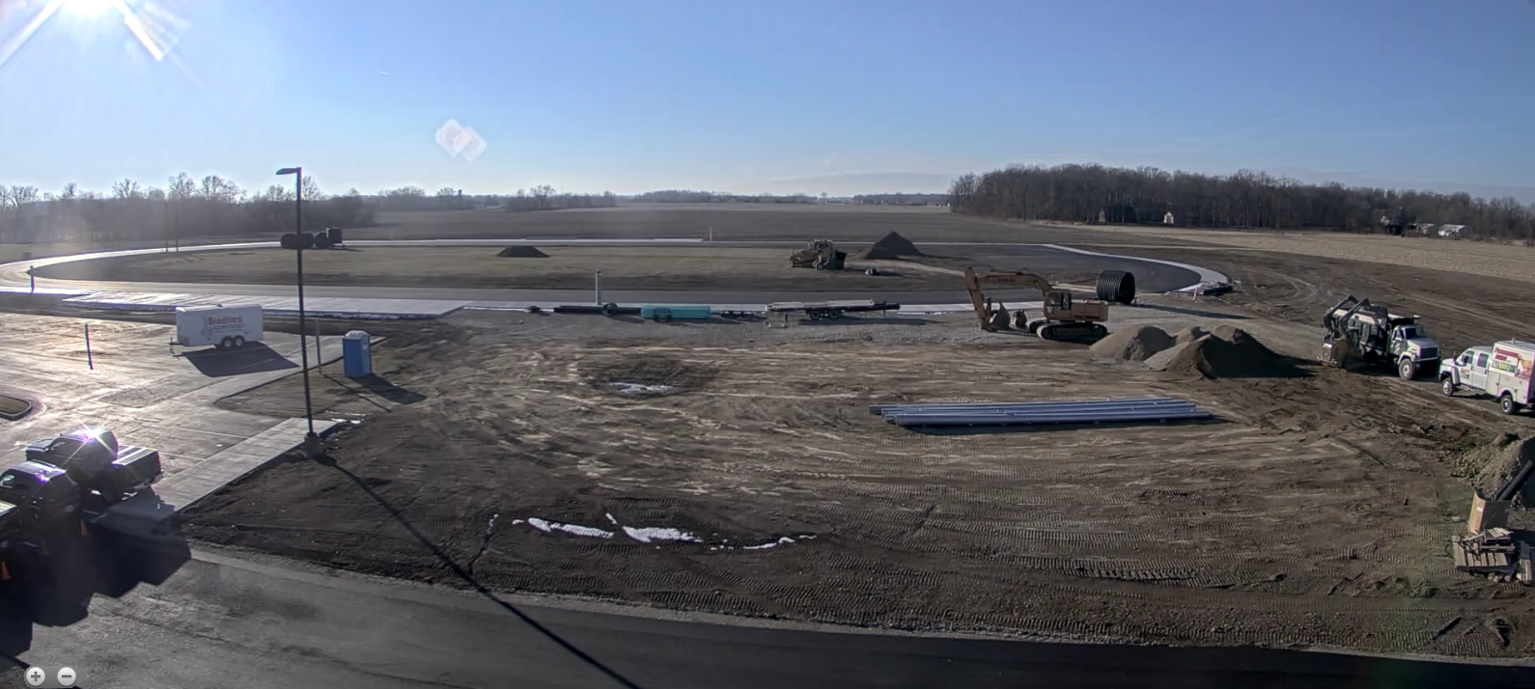
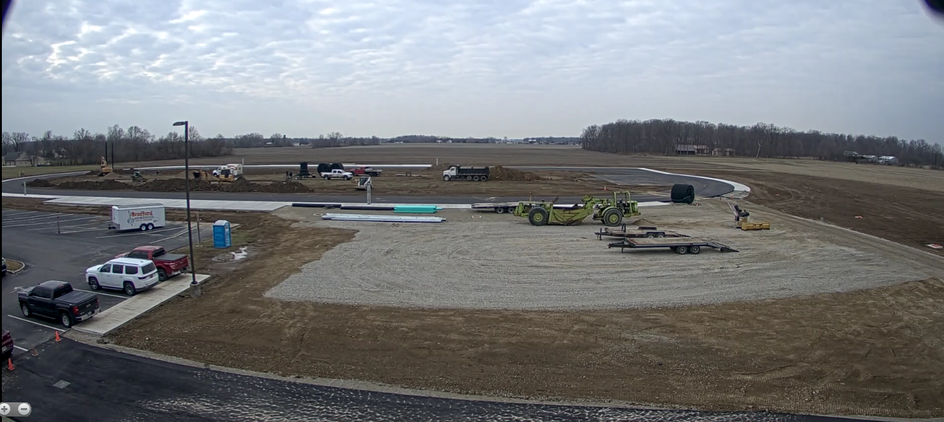
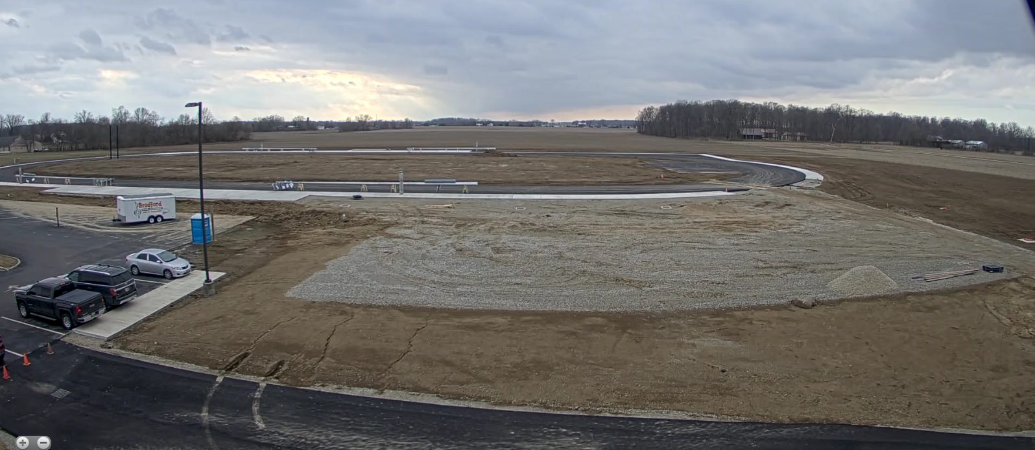
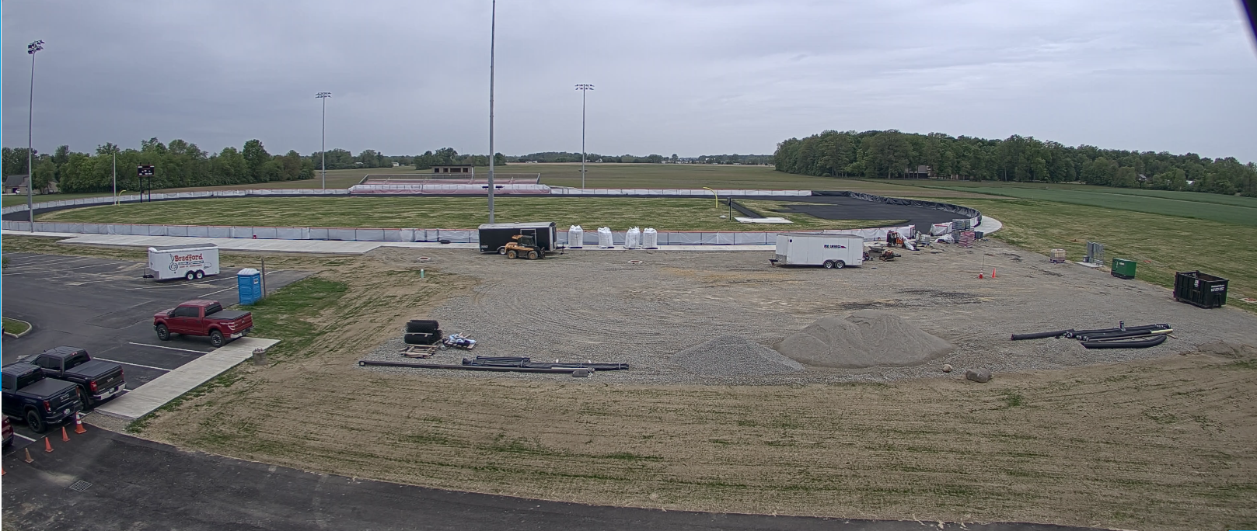

Slide 21
THANK YOU!

